Slide 1
רשתות תקשורת מחשבים
פרק 3 – שכבת התעבורה
עמית דביר
amitdv@ariel.ac.il
בניין סייבר 56.0.49

Slide 2
Transport-Layer Services

Slide 3


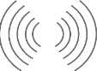
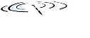


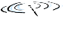



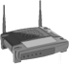




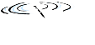


Transport services and protocols
Provide logical communication between app processes running on different hosts
Transport protocols run in end systems
send side: breaks app messages into segments, passes to network layer
rcv side: reassembles segments into messages, passes to app layer
more than one transport protocol available to apps
E.g. TCP, UDP
application
transport
network
data link
physical
logical end-end transport
application
transport
network
data link
physical

Slide 4
Transport vs. network layer
Transport layer: logical communication between processes
Transport layer, relies on, enhances, network layer services
Network layer: logical communication between hosts
household analogy:
12 kids in Ann’s house sending letters to 12 kids in Bill’s house:
hosts = houses
processes = kids
app messages = letters in envelopes
transport protocol = Ann and Bill who demux to in-house siblings
network-layer protocol = postal service

Slide 5
Internet transport-layer protocols
Reliable, in-order delivery (TCP)
congestion control
flow control
connection setup
Unreliable, unordered delivery (UDP)
no-frills extension of “best-effort” IP
Services not available:
delay guarantees
bandwidth guarantees
application
transport
network
data link
physical
network
data link
physical
network
data link
physical
network
data link
physical
logical end-end transport
network
data link
physical
network
data link
physical
network
data link
physical
network
data link
physical
application
transport
network
data link
physical

Slide 6
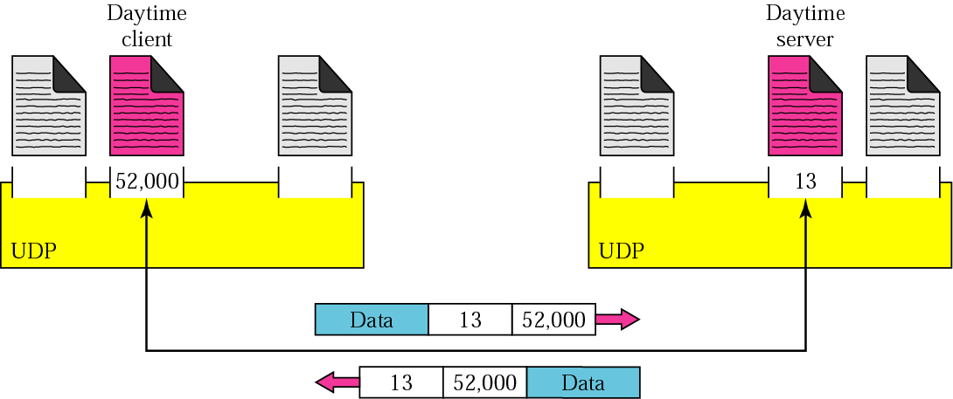
Port numbers concept
Notes:
Here we have client that want the day and time. It then need to send a rq to a Daytime server. (we don’t bother how it works, and who is supposed to answer)
But what’s imptt is that, the client can choose the number of port it want, given only that it’s not a well known port.
Then it need to put the port numb of the proc it want to reach. It’s imptt to understand that w/o this info ,the rx will not be able to transmit the message to the app layer and then the sender will not rx a reply.
For daytime app, the well known port is 13. we understand know why it is imptt to have well know port. It’s not realistic to ask a server every time you need a service what is the port of your service (given that there is a way to enter the name of the service. But theor the name of the app must be the same in the server and the client)

Slide 7
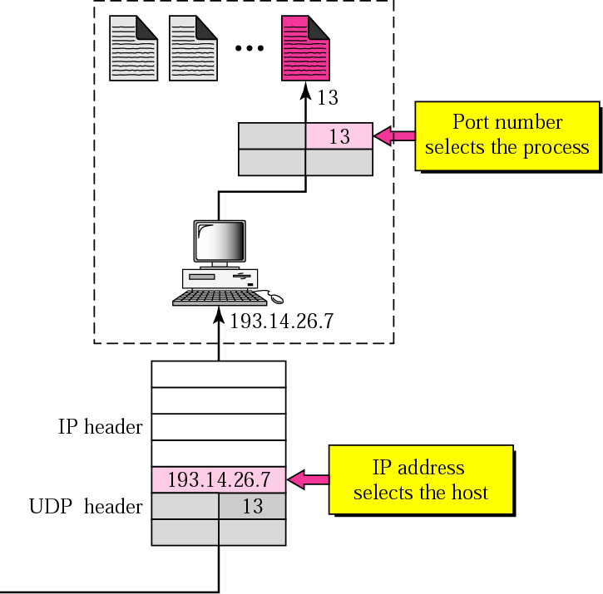
IP addresses versus port numbers
Notes:
It should be clear now, the diff btw IP which allow us to reach the host, and port which is a kind of transport addressing, which allow us to reach a specific proc in the reached host

Slide 8
Which application gets a newly arriving packet?
IP: 74.125.115.99
Operating
System
Transport
Network
Link Layer
Applications
Web server
SSH server
SSH client
Web browser
Skype
Link Layer
Physical Layer
IM
Dest IP: 74.125.115.99

Slide 9
Transport layer multiplexing: TCP
I would like to communicate with 74.125.115.99 port 80
I would like to accept communication on port 80
IP: 128.174.13.63
IP: 74.125.115.99
Operating
System
Operating
System
Web
browser
app
Web
server
app
socket
TCP port 23421
Dest IP: 74.125.115.99
Source IP: 128.174.13.63
Dest port: 80
Source port: 23421
TCP port 80
Network
Network
Link layer
Link layer
An application is identified by the hosts IP addresses, transport protocol, and ports
A TCP connection is identified by the pair of IPs, the pair of ports, and the transport protocol

Slide 10
Transport layer multiplexing: TCP
I would like to communicate with 74.125.115.99 port 80
IP: 128.174.13.63
IP: 74.125.115.99
Operating
System
Operating
System
Web
browser
app
Web
server
app
socket
socket
TCP port 23421
Dest IP: 128.174.13.63
Source IP: 74.125.115.99
Dest port: 23421
Source port:80
TCP port 80
Network
Network
Link layer
Link layer
An application is identified by the hosts IP addresses, transport protocol, and ports
A TCP connection is identified by the pair of IPs, the pair of ports, and the transport protocol

Slide 11
Transport layer multiplexing: TCP
IP: 128.174.13.63
IP: 74.125.115.99
Operating
System
Operating
System
Web
browser
app
Web
server
app
socket
socket
TCP port 23421
Dest IP: 74.125.115.99
Source IP: 128.174.13.63
Dest port: 80
Source port: 23421
TCP port 80
socket
Network
Network
Link layer
Link layer
An application is identified by the hosts IP addresses, transport protocol, and ports
A TCP connection is identified by the pair of IPs, the pair of ports, and the transport protocol

Slide 12
Transport layer multiplexing: TCP
I would like to communicate with 74.125.115.99 port 80
I would like to accept communication on port 80
IP: 128.174.13.63
IP: 74.125.115.99
Operating
System
Operating
System
Web
browser
app
Web
server
app
socket
socket
TCP port 23421
Dest IP: 74.125.115.99
Source IP: 128.174.13.63
Dest port: 80
Source port: 23421
TCP port 80
socket
Network
Network
Link layer
Link layer
An application is identified by the hosts IP addresses, transport protocol, and ports
A TCP connection is identified by the pair of IPs, the pair of ports, and the transport protocol

Slide 13
Transport layer multiplexing: TCP
I would like to send data: XXSFGFEWRV
IP: 128.174.13.63
IP: 74.125.115.99
Operating
System
Operating
System
Web
browser
app
Web
server
app
socket
Dest IP: 74.125.115.99
Source IP: 128.174.13.63
Protocol: TCP
Dest port: 80
Source port: 23421
Data: XXSFGFEWRV
socket
TCP port 23421
Dest IP: 74.125.115.99
Source IP: 128.174.13.63
Protocol: TCP
Dest port: 80
Source port: 23421
Data: XXSFGFEWRV
TCP port 80
TCP port 80
Dest IP: 74.125.115.99
Source IP: 128.174.13.63
Protocol: TCP
Dest port: 80
Source port: 23421
Data: XXSFGFEWRV
socket
Network
Network
Network
Data: XXSFGFEWRV
Link layer
Link layer
Dest IP: 74.125.115.99
Source IP: 128.174.13.63
Protocol: TCP
Dest port: 80
Source port: 23421
Data: XXSFGFEWRV
An application is identified by the hosts IP address, transport protocols, and port
A TCP connection is identified by the pair of IPs, the pair of ports, and the transport protocol

Slide 14
Transport layer multiplexing: UDP
I would like to send/receive data over UDP port 23421
I would like to receive any data on UDP port 1401
IP: 128.174.13.63
IP: 74.125.115.99
Operating
System
Operating
System
IM client
app
IM
server
app
socket
socket
UDP port 23421
UDP port 1401
Network
Network
Link layer
Link layer
An application is identified by the hosts IP address, transport protocols, and port

Slide 15
Transport layer multiplexing: UDP
Send data to 74.125.115.99 port 1401
Data: xxadre
IP: 128.174.13.63
IP: 74.125.115.99
Operating
System
Operating
System
IM client
app
IM
Server
app
socket
socket
UDP port 23421
Dest IP: 74.125.115.99
Source IP: 128.174.13.63
Protocol: UDP
Dest port: 1401
Source port: 23421
Data: xxadre
UDP port 1401
Network
Network
Link layer
Data: xxadre
Link layer
An application is identified by the hosts IP address, transport protocols, and port

Slide 16
connectionless transport: UDP
Notes:
אוניברסיטה - בוקר

Slide 17
UDP: User Datagram Protocol
“no frills,” “bare bones” Internet transport protocol
“best effort” service, UDP segments may be:
Lost
delivered out-of-order to app
Connectionless:
no handshaking between UDP sender, receiver
each UDP segment handled independently of others
UDP use:
DNS
SNMP
why is there a UDP?
no connection establishment (which can add delay)
simple: no connection state at sender, receiver
small header size
no congestion control: UDP can blast away as fast as desired

Slide 18
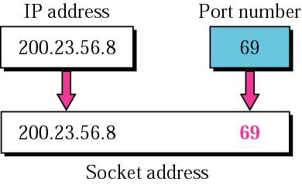
Socket address
To use UDP we need a pair of socket addresses : client socket addr. + server socket addr.
Part of the: IP header and UDP header
Notes:
As we have seen, UDP needs 2 identif : IP and Port, for each end of the connect
The combination of an IP addr and a Port addr is called a socket addr

Slide 19
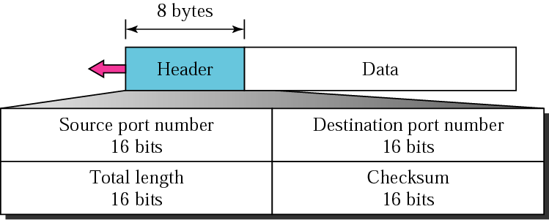
UDP: segment header
Q: So we know what UDP is doing, lets think how is header look like?
length, in bytes of UDP segment, including header
UDP segment format
Notes:
להראות להם גישה ל-UDP דרך המכונות הוירטואליות

Slide 20
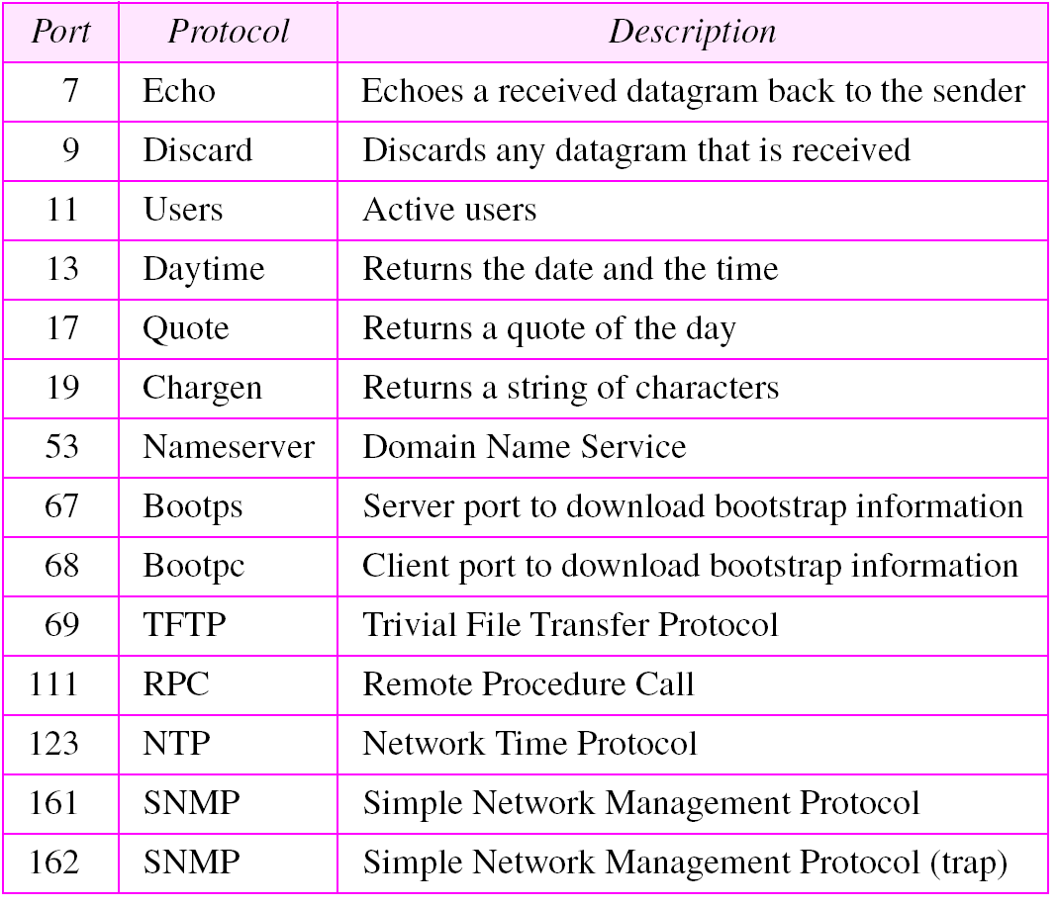
Well-known ports used with UDP
Notes:
https://www.youtube.com/watch?v=MSUBpAylQyc
לבנות שלוש מכונות + להראות להם את ה-Pcap

Slide 21
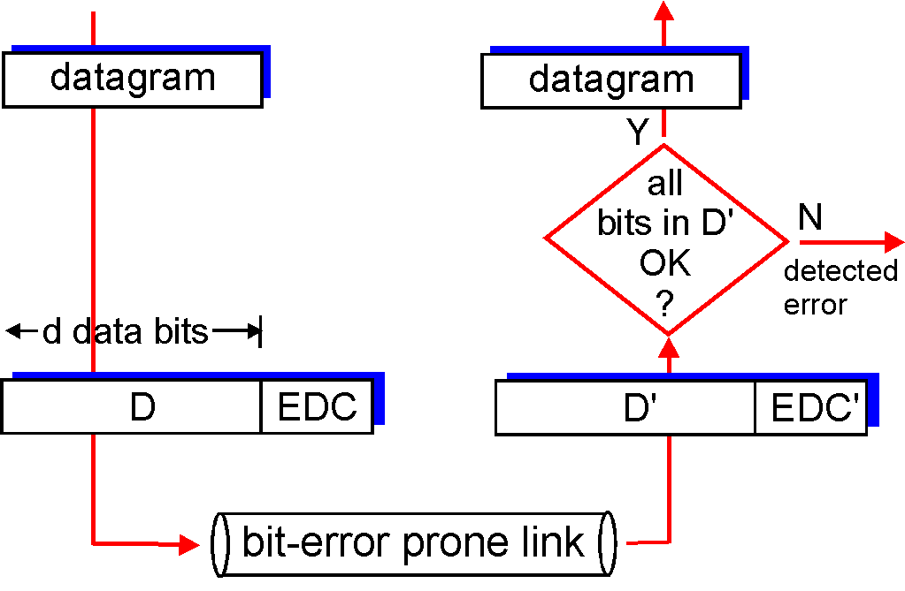
Error detection
EDC= Error Detection and Correction bits (redundancy)
D = Data protected by error checking, may include header fields
Error detection not 100% reliable!
protocol may miss some errors, but rarely
larger EDC field yields better detection and correction
otherwise
Notes:
לנסות לדבר על מוטיבציה

Slide 22
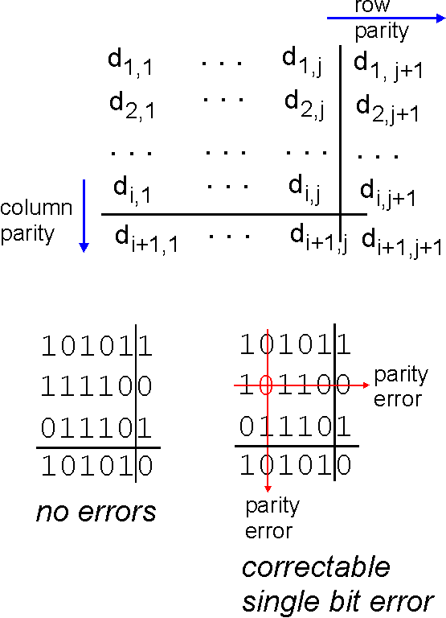
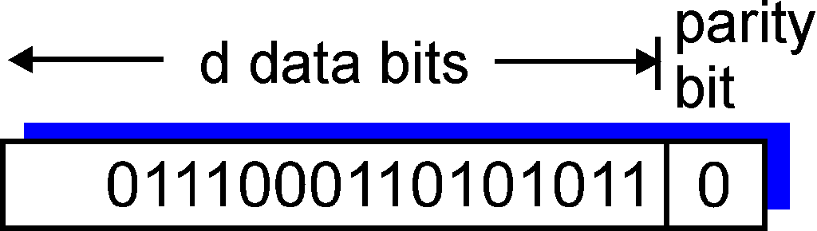
Parity checking
single bit parity:
detect single bit errors
two-dimensional bit parity:
detect and correct single bit errors
1
0
0

Slide 23
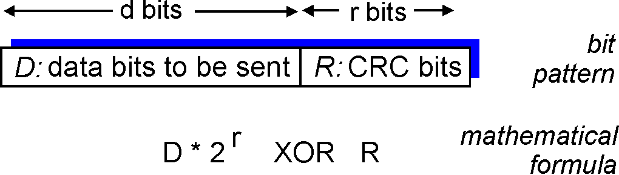
Cyclic redundancy check
more powerful error-detection coding
view data bits, D, as a binary number
choose r+1 bit pattern (generator), G
goal: choose r CRC bits, R, such that
<D,R> exactly divisible by G (modulo 2)
receiver knows G, divides <D,R> by G. If non-zero remainder: error detected!
can detect all burst errors less than r+1 bits
widely used in practice (Ethernet, 802.11 WiFi, ATM)

Slide 24
CRC example
G
D
r = 3
want:
D.2^{r} XOR R = nG
equivalently:
D.2^{r} = nG XOR R
equivalently:
if we divide D.2^{r} by G, want remainder R to satisfy:
1
01000
1001
101110000
1001
-----------------
001010 000
1001
---------------------
000011000
1001
---------------------
01010
1001
----------------------
011
D.2^{r}
G
R = remainder[ ]
R

Slide 25
UDP checksum… what is checksum?
Goal: detect “errors” (e.g., flipped bits) in transmitted segment
sender:
treat segment contents, including header fields, as sequence of 16-bit integers
checksum: addition (one’s complement sum) of segment contents
sender puts checksum value into UDP checksum field
receiver:
compute checksum of received segment
check if computed checksum equals checksum field value:
NO - error detected
YES - no error detected. But maybe errors nonetheless?

Slide 26
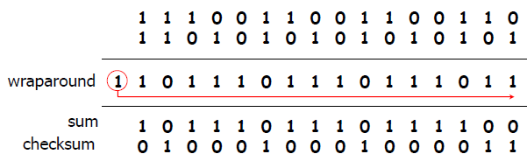
Internet Checksum Example
Note: When adding numbers, a carryout from the most significant bit needs to be added to the result
Example: add two 16-bit integers

Slide 27
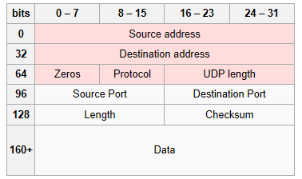
UDP checksum – on what?
Notes:
pseudo header of information from the IP header, the UDP header, and the data

Slide 28
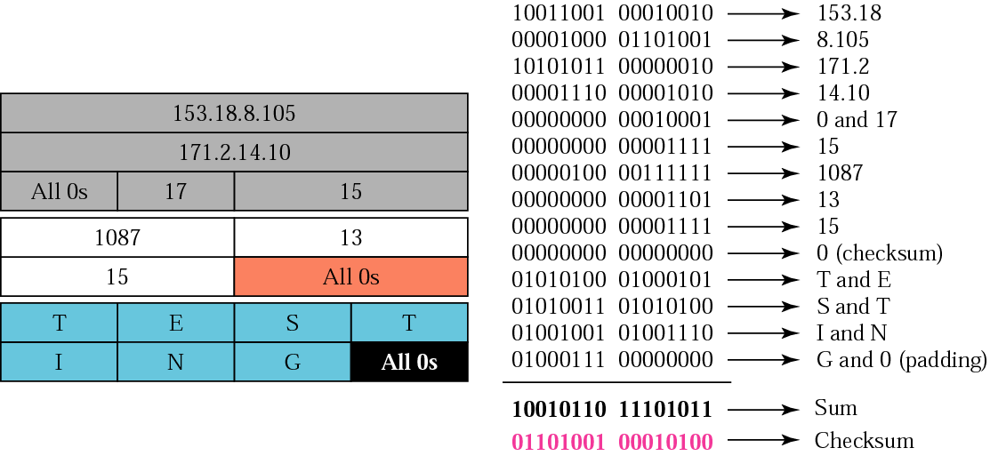
Checksum calculation of a simple UDP user datagram
Checksum optional
Remind all 0’s result is complemented
Notes:
If optional how the dest knows it has not been calculated?
Ans from tcpguide: Note that the use of the Checksum field is optional in UDP. If it is not used, it is set to a value of all zeroes. This could potentially create confusion, however, since when the checksum is used, the calculation can sometimes result in a value of zero. To avoid having the destination think the checksum was not used in this case, this zero value is instead represented as a value of all ones (65,535 decimal).
But what if real was all 1’s and then send o’s

Slide 29
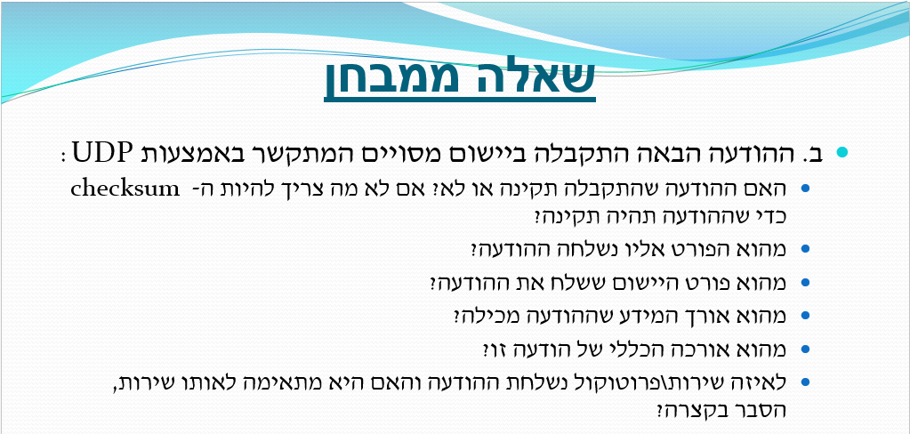
Internet Checksum Example

Slide 30
Internet Checksum Example
0000 | 1010 | 0000 | 0000 | Src port
0101 | 0001 | 0000 | 0000 | Dest port
0100 | 0001 | 0000 | 0000 | length
1010 | 1101 | 0001 | 0001 | Checksum
0000 | 1010 | 0000 | 0000 | Src port
0101 | 0001 | 0000 | 0000 | Dest port
0100 | 0001 | 0000 | 0000 | lengh
1001 | 1100 | 0000 | 0000
0110 | 0011 | 1111 | 1111 | checksum

Slide 31
Internet Checksum Example
0000 | 1010 | 0000 | 0000 | Src port
0101 | 0001 | 0000 | 0000 | Dest port
0100 | 0001 | 0000 | 0000 | lengh
1001 | 1100 | 0000 | 0000
0110 | 0011 | 1111 | 1111 | checksum
Bad Checksum
Source port 160
Destination Port 21, FTP….???
Segment Length 20

Slide 32
principles of reliable data transfer
Notes:
להמשיך מפה

Slide 33
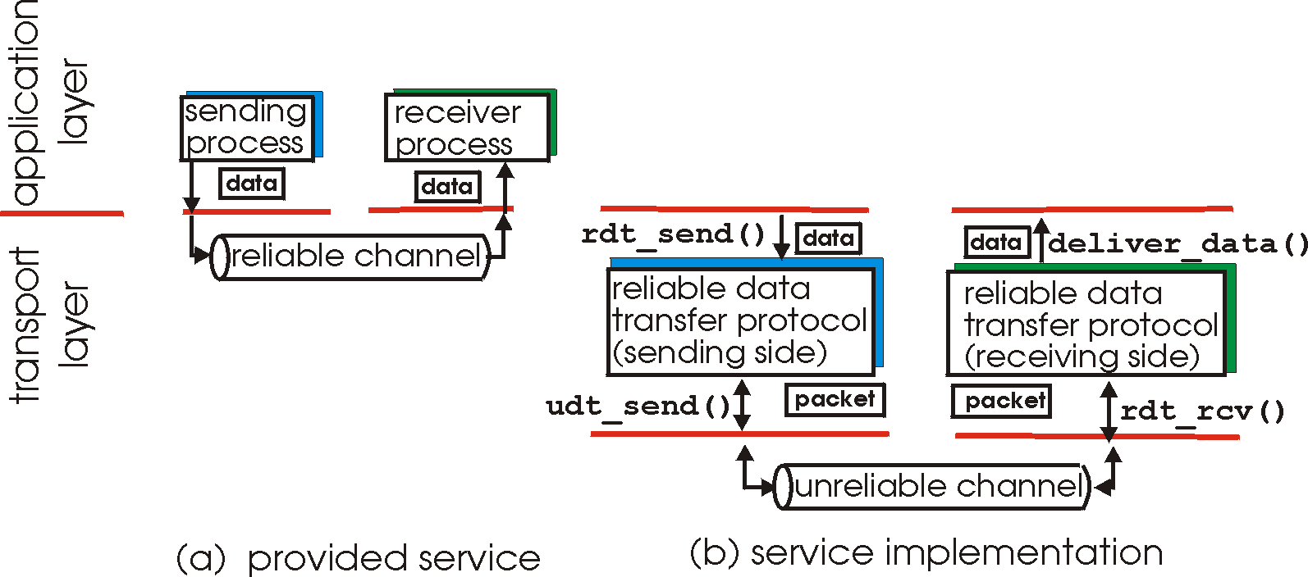
Principles of Reliable data transfer
characteristics of unreliable channel will determine complexity of reliable data transfer protocol (rdt)

Slide 34
Reliable transfer over a reliable channel
underlying channel perfectly reliable
no bit errors
no loss of packets
separate FSMs for sender, receiver:
sender sends data into underlying channel
receiver read data from underlying channel
Wait for call from above
rdt_send(data)
Wait for call from below
rdt_rcv(packet)
extract (packet,data)
deliver_data(data)
packet = make_pkt(data)
udt_send(packet)
sender
receiver

Slide 35

Level 1 Q: Build the reliable data Transfer, channel with bit errors
Think simple – how the protocol will look like
sender
receiver
first packet bit transmitted, t = 0
last packet bit transmitted, t = L / R
first packet bit arrives
last packet bit arrives

Slide 36
Level 1 Q: Build the reliable data Transfer, channel with bit errors
Think simple - How do we know if the packet arrive without any errors
sender
receiver
first packet bit transmitted, t = 0
last packet bit transmitted, t = L / R
first packet bit arrives
last packet bit arrives, check sum?!
Check Sum

Slide 37
Level 1 Q: Build the reliable data Transfer, channel with bit errors
Think simple – Checksum is fine, what next?
sender
receiver
first packet bit transmitted, t = 0
last packet bit transmitted, t = L / R
first packet bit arrives
last packet bit arrives, send ACK
Ack
NACK
Check Sum

Slide 38
Level 1 Q: Build the reliable data Transfer, channel with bit errors
Think simple – received ACK with error?
sender
receiver
first packet bit transmitted, t = 0
last packet bit transmitted, t = L / R
first packet bit arrives
last packet bit arrives, send ACK
Ack
NACK
1-bit
SeqNum
Check Sum

Slide 39
Level 1 Q: Build the reliable data Transfer, channel with bit errors
Think simple – What we can get by using the ACK + Seq num?
sender
receiver
first packet bit transmitted, t = 0
last packet bit transmitted, t = L / R
first packet bit arrives
last packet bit arrives, send ACK
Ack
1-bit
SeqNum
Check Sum

Slide 40
Level 2 Q: Build the reliable data Transfer, channels with errors + loss
Think simple – Ack is coming?
sender
receiver
first packet bit transmitted, t = 0
last packet bit transmitted, t = L / R
Timer set to RTT + epsilon ☺
first packet bit arrives
RTT
last packet bit arrives, send ACK
1-bit
SeqNum
Ack
Timer
Check Sum

Slide 41
Level 2 Q: Build the reliable data Transfer, channels with errors + loss
Think simple – Lets see what is the efficiency of our new algorithm
sender
receiver
first packet bit transmitted, t = 0
last packet bit transmitted, t = L / R
first packet bit arrives
RTT
last packet bit arrives, send ACK
ACK arrives, send next
packet, t = RTT + L / R
Ack
1-bit
SeqNum
Timer
Check Sum
So our new algorithm is good or not
Notes:
=Network utilization פרק זמן שליחת המידע חלקי פרק הזמן הכולל או קצב השידור האפקטיבי חלקי קצב השידור המקסימאלי.

Slide 42
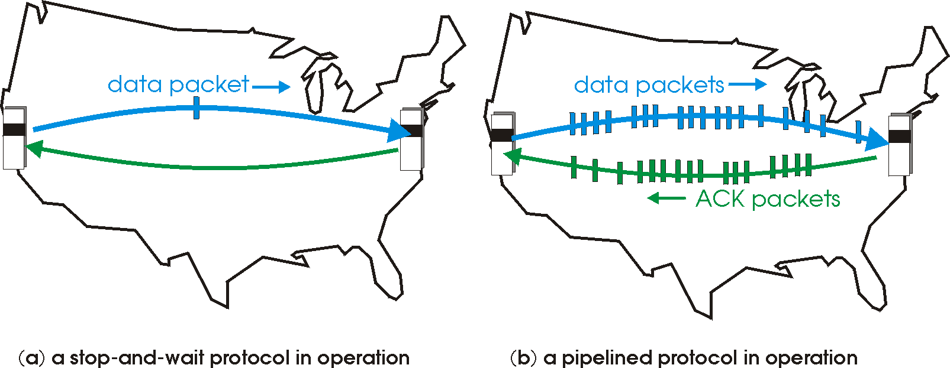

Level 2 Q: Build the next reliable data Transfer
How can we improve it
Pipelining:
sender allows multiple, “in-flight”, yet to be acknowledged pkts
range of sequence numbers must be increased buffering at sender and/or receiver
Ack
n-bit
SeqNum
Timer
two generic forms of pipelined protocols:
go-Back-N, selective repeat
Check Sum
Window

Slide 43
Pipelining: increased utilization
sender
receiver
first packet bit transmitted, t = 0
last bit transmitted, t = L / R
first packet bit arrives
RTT
last packet bit arrives, send ACK
last bit of 2nd packet arrives, send ACK
last bit of 3rd packet arrives, send ACK
ACK arrives, send next
packet, t = RTT + L / R
3-packet pipelining increases
utilization by a factor of 3!

Slide 44
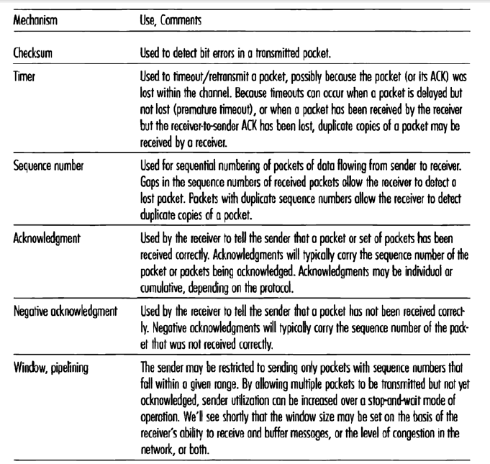
So, in any good transport protocol we need:
Ack
n-bit
SeqNum
Timer
Check Sum
Window

Slide 45
שאלות
מה תפקידו של ה-checksum?
תשובה: לאתר חבילות לא תקינות (הן מידע והן ack)
מה תפקידו של ה-ack?
תשובה: אישור על קבלת חבילות
מה זה cumulative ack?
תשובה: אישור על החבילות שקיבלתי עד כה
מדוע ישנה אפשרות לוותר על NACK?
תשובה: ack + seqnum נותן את אותו פתרון
מה תפקידו של ה-timeout?
תשובה: להתגבר על מצב של אובדן חבילות

Slide 46
שאלות
מה תפקידו של ה-timeout?
תשובה: להתגבר על מצב של אובדן חבילות
מה הקשר הרצוי בין seqnum לגודל החלון?
תשובה: פי 2, על מנת להמנע ממצב של קבלת חבילה שלא נשלחה.
מהו קצב השידור האפקטיבי של פרוטוקול?
תשובה: כמה מידע שהוא שולח ביחידת זמן.
כיצד מחשבים נצילות של פרוטוקול?
תשובה: פרק זמן שליחת המידע חלקי פרק הזמן הכולל או קצב השידור האפקטיבי חלקי קצב השידור המקסימאלי.

Slide 47
connection-oriented transport: TCP
Notes:
אוניברסיטת בוקר

Slide 48
TCP: Overview
point-to-point:
one sender, one receiver
reliable, in-order byte steam:
no “message boundaries”
pipelined:
TCP congestion and flow control set window size
full duplex data:
bi-directional data flow in same connection
MSS: maximum segment size
connection-oriented:
handshaking (exchange of control msgs) inits sender, receiver state before data exchange
flow controlled:
sender will not overwhelm receiver

Slide 49
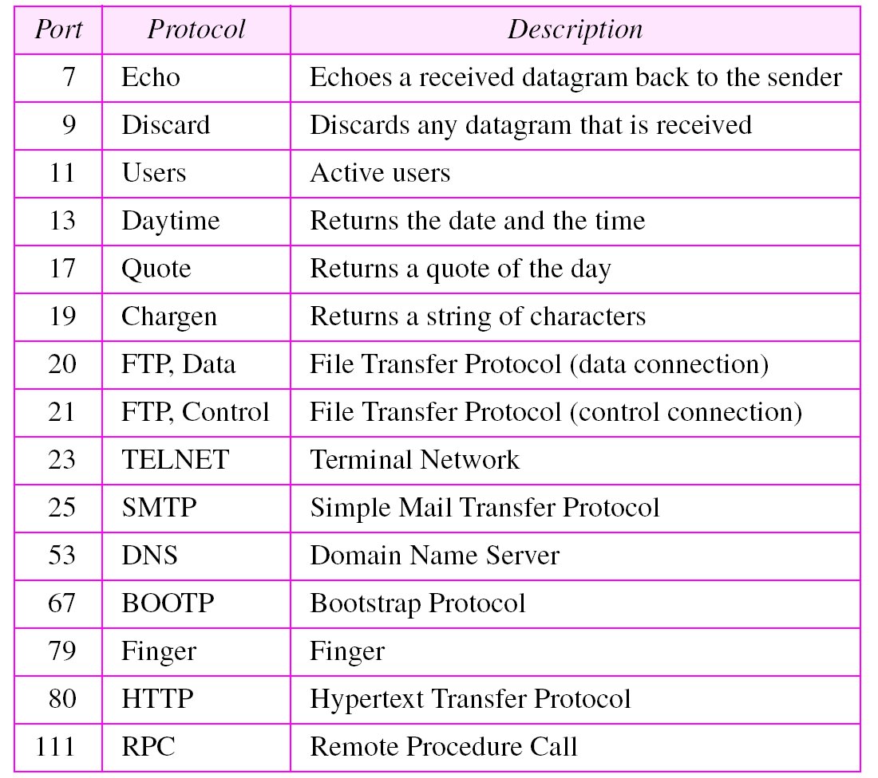
Well-known ports used by TCP

Slide 50
TCP reliable data transfer
TCP creates reliable service on top of IP’s unreliable service
Pipelined segments
Cumulative acks
TCP uses single retransmission timer
TCP spec doesn’t say, how receiver handles out-of-order segments… up to implementer

Slide 51
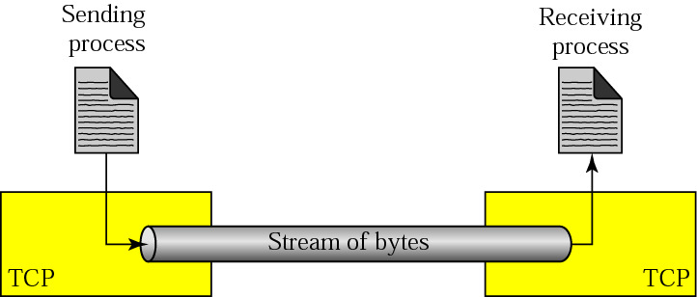
Byte Stream Service
To the lower layers, TCP handles data in blocks, the segments.
To the higher layers TCP handles data as a sequence of bytes and does not identify boundaries between bytes
So: Higher layers do not know about the beginning and end of segments !

Slide 52
TCP - Header

Slide 53
TCP segment - How??
Ports
Seq
Ack
congestion and flow control
Notes:
להראות להם העברת מידע שלם על הלוח
מעבר של הודעה פשוטה
מעבר של פתיחת/סגירה קשר
קבלת חבילה שגויה
נפילת חבילה

Slide 54
TCP segment structure
32 bits
URG: urgent data
(generally not used)
counting
by bytes
of data
(not segments!)
source port #
dest port #
sequence number
ACK: ACK #
valid
acknowledgement number
head
len
not
used
U
receive window
A
PSH: push data now
(generally not used)
P
R
S
F
# bytes
rcvr willing
to accept
checksum
Urg data pointer
RST, SYN, FIN:
connection estab
(setup, teardown
commands)
options (variable length)
application
data
(variable length)
Internet
checksum
(as in UDP)
Notes:
להראות להם העברת מידע שלם על הלוח לפתוח להם wireshark
מעבר של הודעה פשוטה
מעבר של פתיחת/סגירה קשר
קבלת חבילה שגויה
נפילת חבילה
TCP Segment Len - tcp.len

Slide 55
TCP Len != length of packet

Slide 56
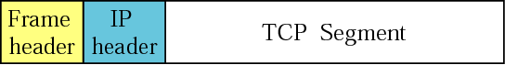
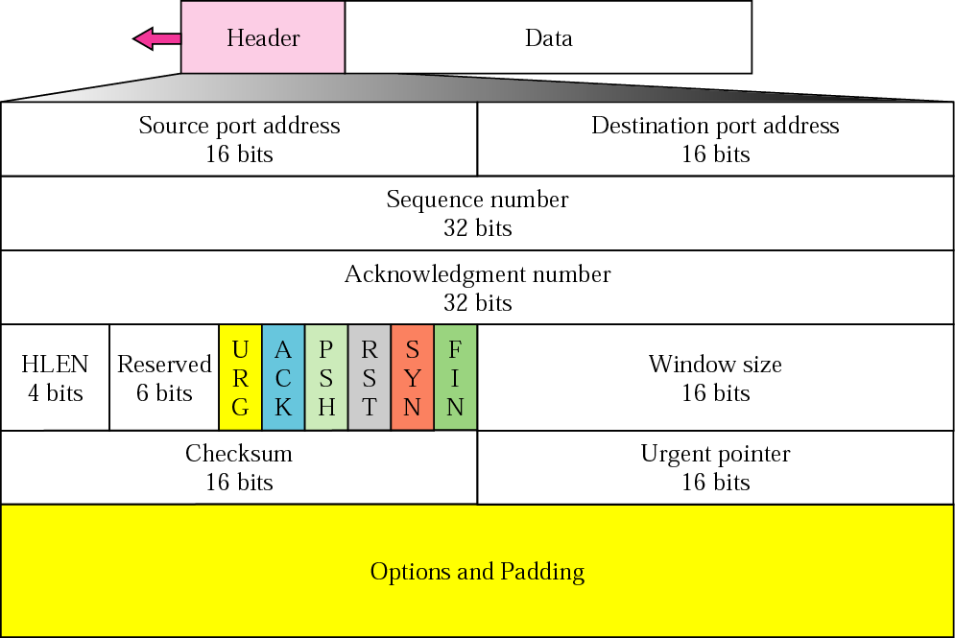
TCP segment format
Notes:
Some of the reserved bits have been used recently for advanced congestion control algo. One of them is “CWR: congestion window reduced ”, and an other is “ECE : ECN (early congestion notification) echo”

Slide 57
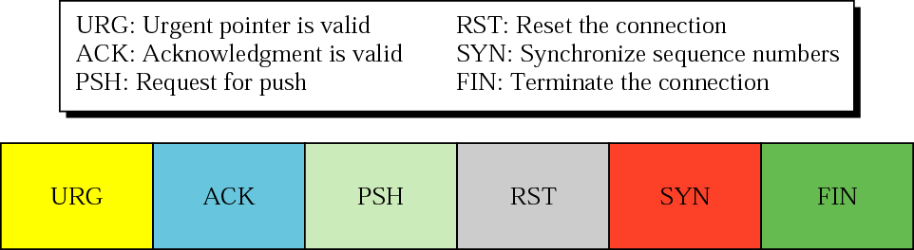
Control field
URG: do not use it [RFC 6093, Jan 2011]
PSH: PUSH Flag
Normally set by sender when the sender’s buffer is empty
Notification from sender to the receiver that the receiver should pass all data that it has to the application.
Useful for interactive applications
Notes:
PSH
Avoid sending tcp to wait for filling a segment (with a size defined by tcp). But this is more for receiver side to not wait for more data before transmitting to receiving APP.
Thus appl tell sending tcp to make a pkt with this data even if short. Tells also the rx not to wait for more data (from the same) to pass it to the appl (but I thought the rx pass the data to the appl as soon as it’s possible ? Why do the rx will wait for more data to arrive before passing them to the appl ? Answer: don’t want to bother the app for each byte that arrives. But the question now is when does receiving buffer decide when to pass to the receive APP?
Ex of keystroke in interactive appl. Also typical example is SSH
Urgent Data- no longer relevant since we refer to RFC6093 that do not advise using URG
Normally TCP is stream oriented proto, thus receiver read only in the order (remember it was one of the adv of tcp)
But sometimes need that data read out of order. Ex: prog send data to the rx to process them. When results of proc comes back, sender finds that everything is wrong. It want to abort the proc, but already sent huge amount of data. Issues abort cmd (ctrl +c ), but stored in the buffer and will be tx after all data proc
Sol is urg bit. Tells the sending tcp that urg data to be sent. Tcp creates a seg and insert data at the beg. The rest of data can be normal, pointer defines the end of the urg data.
When rx tcp rx the segment, extract the urg data, and deliver it out of order to the rx appl prog
(does the urge bit can also forced the rx to read the urgent data before other data still in the buffer, or only to force reading this data before other data in the SAME segment ?)

Slide 58
TCP header fields
Flag bits:
RST: Reset the connection
The flag causes the receiver to reset the connection
Receiver of a RST terminates the connection and indicates higher layer application about the reset
SYN: Synchronize sequence numbers
Sent in the first packet when initiating a connection
FIN: Sender is finished with sending
Used for closing a connection
Both sides of a connection must send a FIN
Notes:
Tell them, will understand better when we will see the case further

Slide 59
Resetting Connections
Resetting connections is done by setting the RST flag
When is the RST flag set?
Denying a connection: Connection request arrives and no server process is waiting on the destination port
Abort (Terminate) a connection Causes the receiver to throw away buffered data. Receiver does not acknowledge the RST segment
Notes:
Denying : common situation when server denies tcp conn because the dest port num in the SYN seg defines a server that is not in the LISTEN state at the moment. After rx SYN the server sends an RST+ACK that ACK the SYN and at the same time resets(denies) the conn. (what the server has to do to be in LISTEN state ?)
Sometimes firewall installed at the server prevent some port to be opened thus upon receiving a segment, the firewall (not the server itself) generate a RST.
Abort : a proc can abort a conn instead of closing it. E.g. if does not want the data in the queue due to discrepancy (difference) in the data. TCP may also want to abort e.g. if rx a seg belonging to a a previous conn. The side that want to abort send an RST+ACK to the other side and then throw away all the data, and the other side made this also.

Slide 60
TCP - connection management
Notes:
יום ראשון

Slide 61

Connection Management
Before exchanging data, sender/receiver “handshake”:
agree to establish connection (each knowing the other willing to establish connection)
agree on connection parameters
application
application
connection state: ESTAB
connection variables:
seq # client-to-server
server-to-client
rcvBuffer size
at server,client
connection state: ESTAB
connection Variables:
seq # client-to-server
server-to-client
rcvBuffer size
at server,client
network
network
Socket clientSocket =
newSocket("hostname","port number");
Socket connectionSocket = welcomeSocket.accept();

Slide 62
TCP 3-way handshake
Therefore, what we need?
client state
server state
LISTEN
LISTEN
choose init seq num, x
send TCP SYN msg
SYNSENT
SYNbit=1, Seq=x
choose init seq num, y
send TCP SYNACK
msg, acking SYN
SYN RCVD
SYNbit=1, Seq=y
ACKbit=1; ACKnum=x+1
received SYNACK(x)
indicates server is live;
send ACK for SYNACK;
this segment may contain
client-to-server data
ESTAB
ACKbit=1, ACKnum=y+1
received ACK(y)
indicates client is live
ESTAB

Slide 63
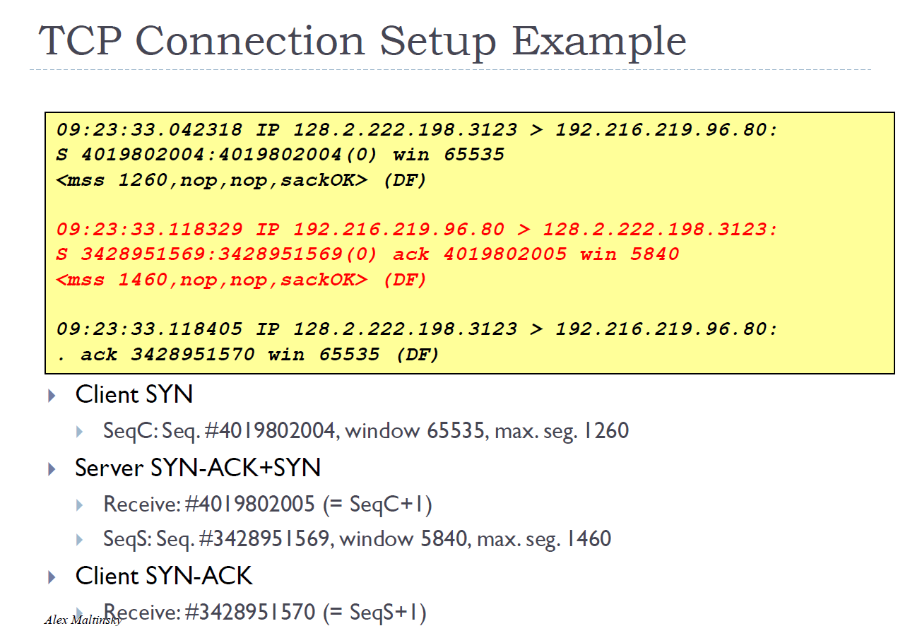

Slide 64
TCP 3-way handshake: FSM
closed
Socket connectionSocket = welcomeSocket.accept();
Λ
Socket clientSocket =
newSocket("hostname","port number");
SYN(x)
SYNACK(seq=y,ACKnum=x+1)
create new socket for
communication back to client
listen
SYN(seq=x)
SYN
rcvd
SYN
sent
SYNACK(seq=y,ACKnum=x+1)
ACK(ACKnum=y+1)
ESTAB
ACK(ACKnum=y+1)
Λ

Slide 65
TCP: closing a connection
Client, server each close their side of connection
send TCP segment with FIN bit = 1
Respond to received FIN with ACK
on receiving FIN, ACK can be combined with own FI
simultaneous FIN exchanges can be handled
client state
server state
ESTAB
ESTAB
clientSocket.close()
FIN_WAIT_1
can no longer
send but can
receive data
FINbit=1, seq=x
CLOSE_WAIT
ACKbit=1; ACKnum=x+1
can still
send data
FIN_WAIT_2
wait for server
close
LAST_ACK
FINbit=1, seq=y
TIMED_WAIT
can no longer
send data
ACKbit=1; ACKnum=y+1
timed wait
for 2*max
segment lifetime
CLOSED
CLOSED

Slide 66
TCP: closing a connection
client state
server state
ESTAB
ESTAB
clientSocket.close()
FIN_WAIT_1
can no longer
send but can
receive data
FINbit=1, seq=x
CLOSE_WAIT
ACKbit=1; ACKnum=x+1
can still
send data
FIN_WAIT_2
wait for server
close
LAST_ACK
FINbit=1, seq=y
TIMED_WAIT
can no longer
send data
ACKbit=1; ACKnum=y+1
timed wait
for 2*max
segment lifetime
CLOSED
CLOSED

Slide 67
SYN flooding attack
One of the “denial of service (DoS)” attack
System monopolized with so many request that it collapses and denies service to every request
Sends large numb of SYN segment with fake source IP addr.
TCP vulnerable due to allocation of resources before completing the 3-way handshake
TCP server sends SYN+ACK to the fake clients, which are lost
Solutions:
Limited number of connection request during a specified period of time
Filter out datagrams from unwanted address
Postpone resource allocation until the entire connection is set up: SYN cookie
Notes:
Les cas pathologiques, genre simultaneous open etc, pas traiter
SYN cookie: the cookie consist in a secret number generated for ISN based on IP addr , and secret key etc… the server do not save this key because it can generate it again whenever it want based on the info
So if someone send syn and receive syn+ack from the server it has to answer with ack fiiting the syn sent by the server. Then the server check the akno of the ack which is supposed to be the secret isn generated previoulsy +1
Of course this do not prevent attack if ack is sent also but it more rare

Slide 68
Connection with losses
SYN
Total waiting time
3+6+12+24+48+64 = 157sec
3 sec
SYN
2x3=6 sec
SYN
12 sec
SYN
64 sec
Give up

Slide 69
SYN Attack
attacker
SYN: to port 80, from port 12344
Reserve memory for TCP connection.
Must reserve enough for the receiver buffer.
And that must be large enough to support high data rate
ignored
SYN-ACK
SYN: to port 80 from 1235
SYN
SYN
SYN
SYN
157sec
SYN
SYN
Victim gives up on first SYN-ACK and frees first chunk of memory

Slide 70
SYN Attack
attacker
SYN
ignored
SYN-ACK
SYN
Total memory usage:
Memory per connection x number of SYNs sent in 157 sec
Number of syns sent in 157 sec:
157 x 10Mbps / (SYN size x 8) = 157 x 31250 = 5M
Suppose Memory per connection = 20K
Total memory = 20K x 5M = 100GB … machine will crash
SYN
SYN
SYN
SYN
157sec
SYN
SYN

Slide 71
Defense from SYN Attack
attacker
SYN
If too many SYNs come from the same host, ignore them
ignored
SYN-ACK
SYN
SYN
SYN
ignore
SYN
ignore
SYN
ignore
SYN
ignore
SYN
ignore
Better attack
Change the source address of the SYN to some random address

Slide 72
SYN Cookie
Do not allocate memory when the SYN arrives, but when the ACK for the SYN-ACK arrives
The attacker could send fake ACKs
But the ACK must contain the correct ACK number
Thus, the SYN-ACK must contain a sequence number that is
not predictable and does not require saving any information.
This is what the SYN cookie method does
Seq no=2197
Ack no = xxxx
SYN=1
ACK=0
Reset the sequence number
Send SYN
The ACK no is invalid
Although no new data has arrived, the ACK no is incremented (2197 + 1)
Send SYN-ACK
Seq no = 12
ACK no = 2198
SYN=1
ACK=1
Send ACK
(for syn)
Although no new data has arrived, the ACK no is incremented (2197 + 1)
Seq no = 2198
ACK no = 13
SYN = 0
ACK =1
Allocate
memory

Slide 73
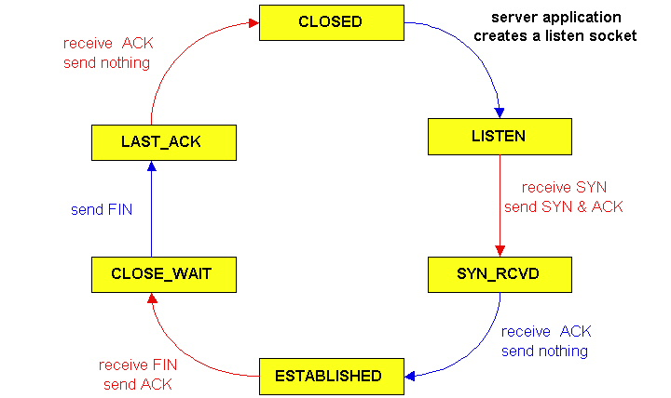
TCP – Life Cycle
72

Slide 74
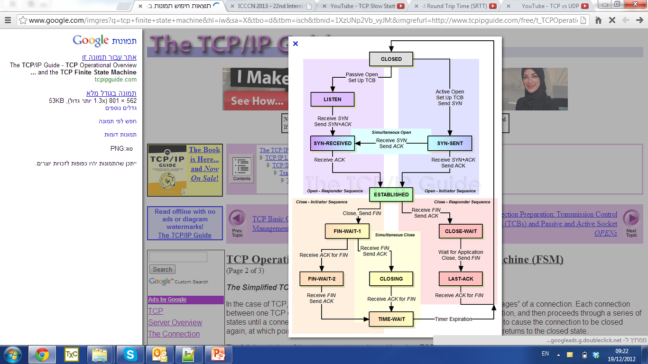
-
- http://packetlife.net/blog/2010/jun/7/understanding-tcp-sequence-acknowledgment-numbers
Notes:
https://www.youtube.com/watch?v=yDBk39ZGPdw
להרים שלוש מכונות עם סקריפט ואז להראות להם איך זה עובר

Slide 75
TCP States

Slide 76
2MSL Wait State
2MSL Wait State = TIME_WAIT
When TCP does an active close, and sends the final ACK, the connection must stay in in the TIME_WAIT state for twice the maximum segment lifetime.
2MSL= 2 * Maximum Segment Lifetime
Why? TCP is given a chance to resent the final ACK. (Server will timeout after sending the FIN segment and resend the FIN)
The MSL is set to 2 minutes or 1 minute or 30 seconds.

Slide 77
TCP – Data Transfer

Slide 78
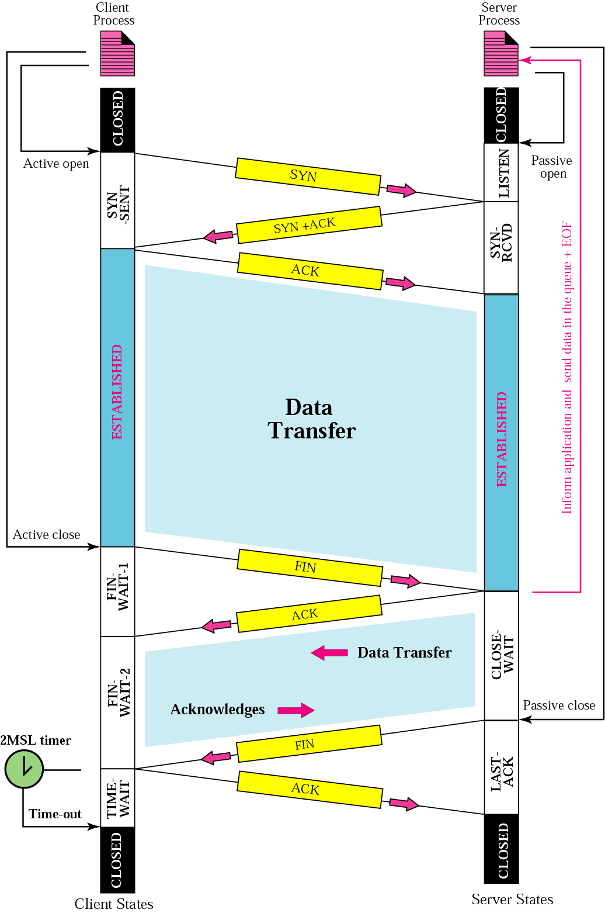
Common scenario
Notes:
What is pink line in the right EOF etc.. ?
The Max Segment Lifetime is the max time a segment can exist in the internet before being dropped. Remember tcp is encapsulated in IP which has a TTL. The common value for MSL is btw 30 sec and 1 mn. 2 reasons for time wait and 2 MSL:
1/ if the last ack of the client is lost, the server will retx a FIN seg (after timeout of the server expired). But if the client already closed the connection, won’t beable to rx the retx fin seg, and thus won’t send ack, and thus server won’t be able to close the connect. Thus give sufficient time for an ack to be lost and fin to be retx.
2/ if new connection btw client and server is established, with the same port num etc… called “incarnation”, thus they can rx pkt from the old connect, if not sufficient time after closing. To prevent this pb, tcp requires incarnation cannot take place before 2 MSL elapsed. (this condition can be ignored if ISN of incarnation greater than old connect)

Slide 79
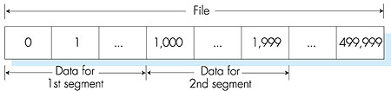
TCP seq. numbers, ACKs
outgoing segment from sender
sequence numbers:
byte stream “number” of first byte in segment’s data
The sequence number for a segment is the first byte-stream # of the first byte in the segment.
acknowledgements:
seq # of next byte expected from other side
cumulative ACK
source port #
dest port #
sequence number
acknowledgement number
rwnd
checksum
urg pointer
window size
N
sender sequence number space
sent
ACKed
sent, not-yet ACKed
(“in-flight”)
usable
but not
yet sent
not
usable
incoming segment to sender
source port #
dest port #
sequence number
acknowledgement number
A
rwnd
checksum
urg pointer

Slide 80
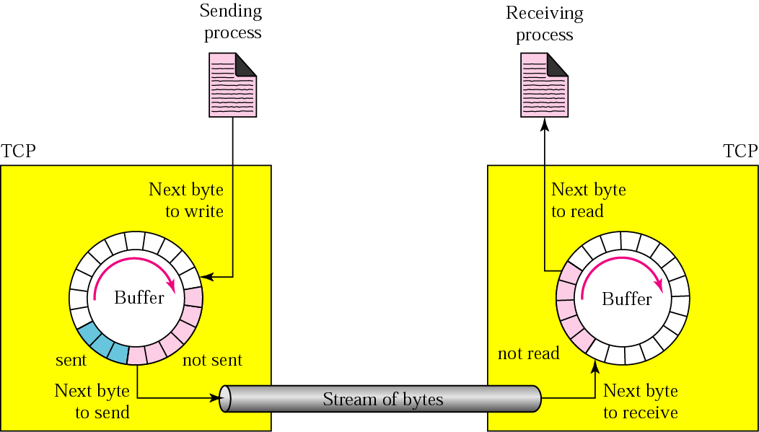
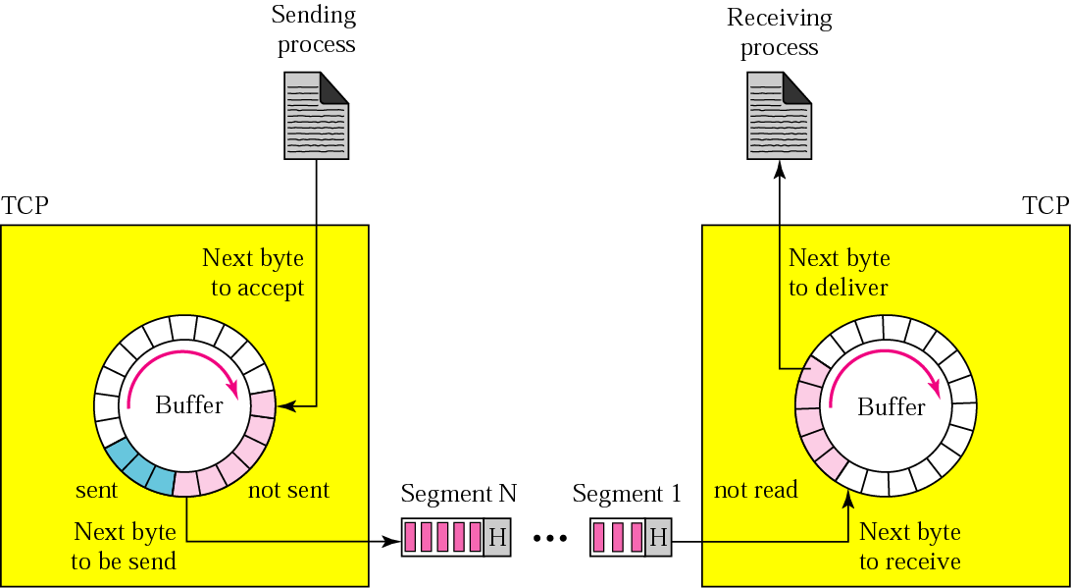
Sending and receiving buffers
Notes:
Stud question: where is the buffer stored ? On the NIC or in the disk memory of the computer ?
Stud quest2: how does the sender informs the appli layer that the buffer is full and that the rx cannot accept new segment for the moment ?
As said, because sending and rx proc may not write or read data at the same speed, tcp needs buffers for storage.
There is 2 buffers for each direct. (here only one for each, for purpose of ex)
These buffers are also needed for the purpose of flow and error ctrl as we will see further.
One way of buffer is: circular array of 1byte location, as here.
Of course in real, buffer of thousands of bytes, and not necessary the same size at the 2 end
At sending side 3 type of rooms: -white : empty and can be filled by sending proc, -blue: already sent but not yet ack keep them until ack, -pink: to be sent
As we will see later, tcp can send only part of pink section: or because congestion on net, or because slowness of rx proc
In rx side: simpler, white: empty can be filled by bytes rx from net, -pink: byte that can be read by the rx proc, and when read, room recycled
Transition to the backfront slide:
Although buffering handles disparity btw speed of produc and consum proc, we need one more step to send data.
Ip need to send data in pkt , not stream.
Thus tcp groups number of bytes together to make a segment. Note that segment not necessarily the same size

Slide 81
Window Management in TCP
The receiver is returning two parameters to the sender
The interpretation is:
I am ready to receive new data with
SeqNo= AckNo, AckNo+1, …., AckNo+Win-1
Receiver can acknowledge data without opening the window
Receiver can change the window size without acknowledging more data

Slide 82
TCP Transmission Categories, Send Window and Pointers
Usable Window Size
SEND.UNA+SEND.WND-SEND.NXT =
32+20-46=6
Send Window
SEND.WND = 20
Left edge of
send window
Right edge of
send window
…..
28
29
30
31
32
33
34
35
36
37
38
39
40
41
42
43
44
45
46
47
48
49
50
51
52
53
54
55
56
57
…..
Sent and
Acknowledge
(31 bytes)
Sent but not yet
Acknowledge
(Sent and still outstanding)
Not sent
Recipient
Ready
To receive
Not sent
Recipient
not Ready
To receive
Send Unacknowledged
Pointer
SEND.UNA = 32
Send Next
Pointer
SEND.NXT = 46

Slide 83
TCP Receive Categories and Pointers
Receive Window
RCV.WND = 20
Left edge of
receive window
Right edge of
receive window
…..
28
29
30
31
32
33
34
35
36
37
38
39
40
41
42
43
44
45
46
47
48
49
50
51
52
53
54
55
56
57
…..
Received and
Acknowledge
(31 bytes)
Not yet received, transmitter permitted to send
(20 bytes)
Not yet received
Transmitter may
not send
Receive Next
Pointer
RCV.NXT = 32
Note: Prior to receiving 14 bytes that have been sent

Slide 84
TCP Transaction Example Showing Server’s Send Pointers
RCV.WND=200
Client
Server
SND.UNA=241
SND.WND=200
Usable=200
Send Request
Request
Len=140
Seq=1
SND.NXT=241
RCV.NXT=241
Receive Request, send
combined ACK and Reply
SND.UNA=241
SND.WND=200
Usable=120
Reply
Len=80
Seq=241
Ack=141
Receive combined ACK and Reply, send ACK
80
RCV.WND=200
Send part 1 of requested file
SND.NXT=321
Ack=321
File 1
Len=120
Seq=321
SND.UNA=241
SND.WND=200
Usable=0
80
RCV.NXT=321
80
120
Receive part 1 of requested file, send ACK
SND.NXT=441
Receive ACK for Reply
SND.UNA=321
SND.WND=200
Usable=80
RCV.WND=200
Ack=441
80
120
80
120
Receive ACK for part 1 of file
SND.NXT=441
RCV.NXT=441
SND.UNA=441
SND.WND=200
Usable=200
80
120
Receive part 2 of requested file, send ACK
File 2
Len=160
Seq=441
Send part 2 of requested file
SND.NXT=441
SND.UNA=441
SND.WND=200
Usable=40
RCV.WND=200
Ack=601
80
120
160
80
120
160
SND.NXT=601
Receive ACK for part 2 of file
SND.UNA=601
SND.WND=200
Usable=200
RCV.NXT=601
80
120
160
SND.NXT=601

Slide 85
TCP Transaction Example Showing Client’s Send Pointers
SND.UNA=1
SND.WND=360
Usable=360
Client
Server
RCV.WND=360
Send Request
Request
Len=140
Seq=1
RCV.NXT=1
SND.NXT=1
Receive Request, send
combined ACK and Reply
SND.UNA=1
SND.WND=360
Usable=220
RCV.WND=360
Reply
Len=80
Seq=241
Ack=141
140
140
SND.NXT=141
Receive combined ACK and Reply, send ACK
Send part 1 of requested file
RCV.NXT=141
File 1
Len=120
Seq=321
SND.UNA=141
SND.WND=360
Usable=360
Ack=321
140
Receive ACK for Reply
SND.NXT=141
Receive part 1 of requested file, send ACK
Ack=441
Receive ACK for part 1 of file
File 2
Len=160
Seq=441
Send part 2 of requested file
Receive part 2 of requested file, send ACK
Ack=601
Receive ACK for part 2 of file

Slide 86
TCP ACK generations rules
If sending data, must include (piggyback) an ACK giving next sequence number expected ➔ reduce traffic
If no data to send, and received only one in-order segment, delay the ACK until another segment arrives or until period of time (e.g. 500ms) has passed ➔prevents extra traffic
If new in order segment, and past in order segment not already ACK , send immediately ACK ( straightforward of 2)
If out of order segment received, send immediately an ACK with next expected SeqNo ➔ leads to fast retransmission
When missing segment arrives, send an ACK ➔ informs sender that missing segments received
If duplicate segment arrives, send immediately ACK ➔ solve pb of lost ACK
Notes:
ACK segments do not consume sequence numbers and are not acknowledged

Slide 87
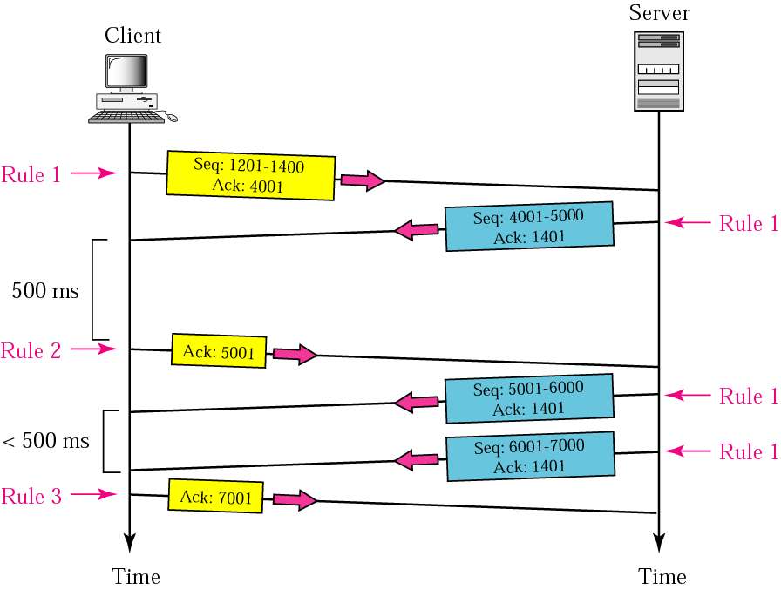
Normal operation

Slide 88
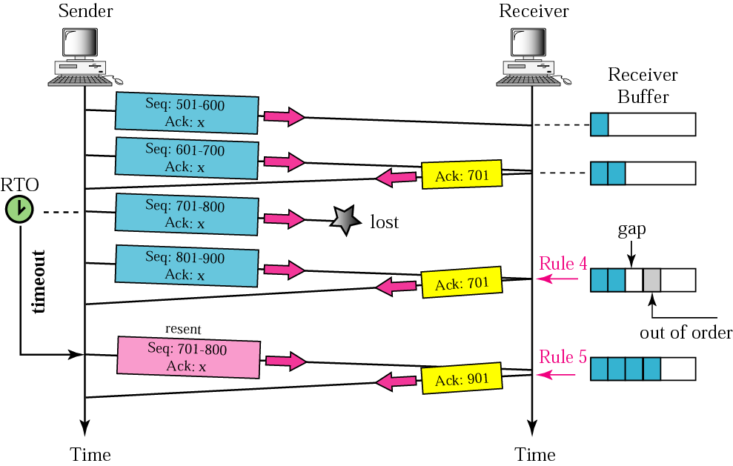
Lost segment
Notes:
Lost or corrupted seg is treated the same way by the rx. Only diff is that lost is discarded somewhere in the net and corrupted discarded by the rx itself. But both considered lost. In our ex lost, perhaps due to congestion and discarded by a router.
Here show only ACK for segt 3, but remaining seg also

Slide 89
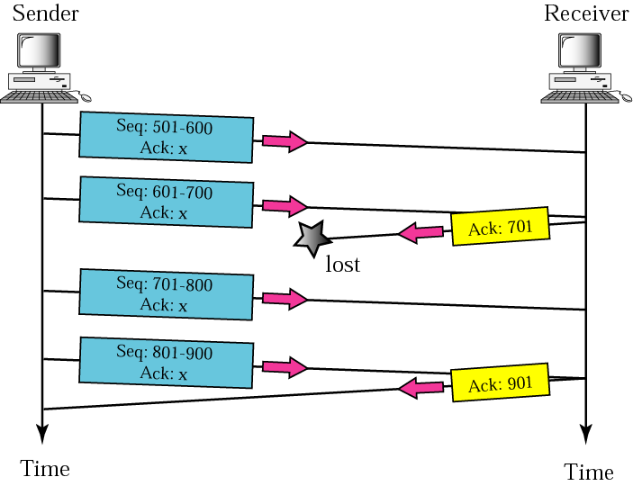
Lost acknowledgment
Notes:
Since we have a cumulative ack, even if sometimes an ack get lost, if meanwhile the sx receive an ack that includes seqno of the previous lost ack , all things are corrected, w/o even that the sx know about the loss of the previous ack

Slide 90
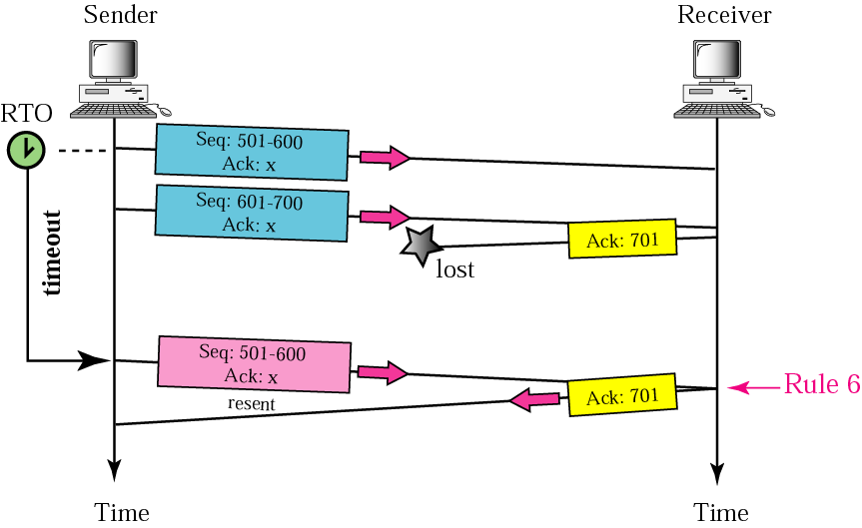
Lost acknowledgment corrected by resending a segment
Notes:
Here the ack get lost, but no other ack arrives meanwhile, thus after timer expires, the sender retx the first seg non ack. The rx sends immediately an ack including an ack on the second segment rx, to avoid the sender rx also the second.
But from the rx point of view the duplicate seg is discarded (always do this when rx a seg with seqno less than the previously ack bytes)

Slide 91
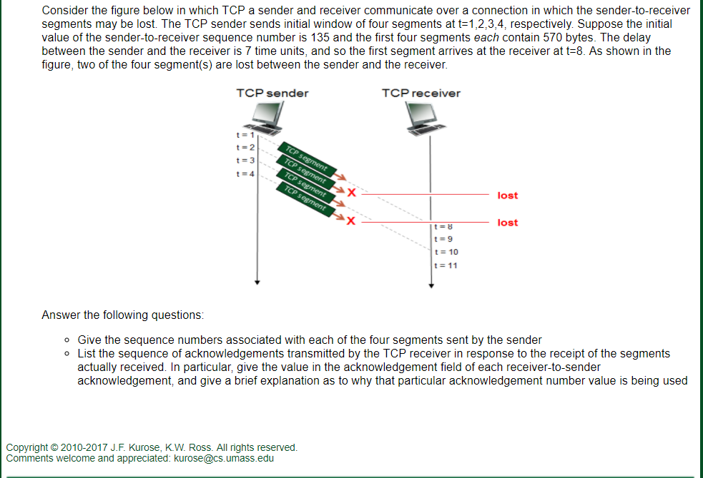
Lost

Slide 92
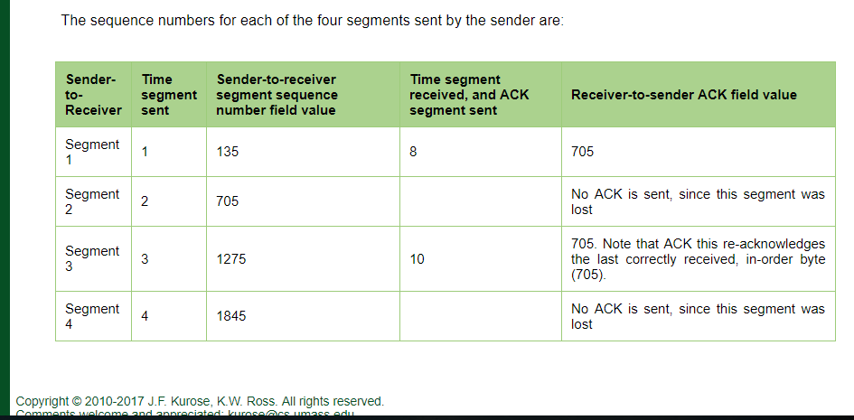

Slide 93
TCP ACK generation
event at receiver
arrival of in-order segment with
expected seq #. All data up to
expected seq # already ACKed
arrival of in-order segment with
expected seq #. One other
segment has ACK pending
arrival of out-of-order segment
higher-than-expect seq. # .
Gap detected
arrival of segment that
partially or completely fills gap
TCP receiver action
delayed ACK. Wait up to 500ms
for next segment. If no next segment,
send ACK
immediately send single cumulative
ACK, ACKing both in-order segments
immediately send duplicate ACK,
indicating seq. # of next expected byte
immediate send ACK, provided that
segment starts at lower end of gap

Slide 94
TCP fast retransmit
time-out period often relatively long:
long delay before resending lost packet
WHAT TO DO….
TCP fast retransmit
if sender receives 3 ACKs for same data
(“triple duplicate ACKs”), resend unacked segment with smallest seq #
likely that unacked segment lost, so don’t wait for timeout
(“triple duplicate ACKs”),
detect lost segments via duplicate ACKs.
sender often sends many segments back-to-back
if segment is lost, there will likely be many duplicate ACKs.
Notes:
להמשיך מפה

Slide 95
TCP fast retransmit
Host A
Host B
Seq=92, 8 bytes of data
Seq=100, 20 bytes of data
X
ACK=100
timeout
ACK=100
ACK=100
ACK=100
Seq=100, 20 bytes of data
fast retransmit after sender
receipt of triple duplicate ACK
Notes:
להדגיש שהתחילו עם 2

Slide 96
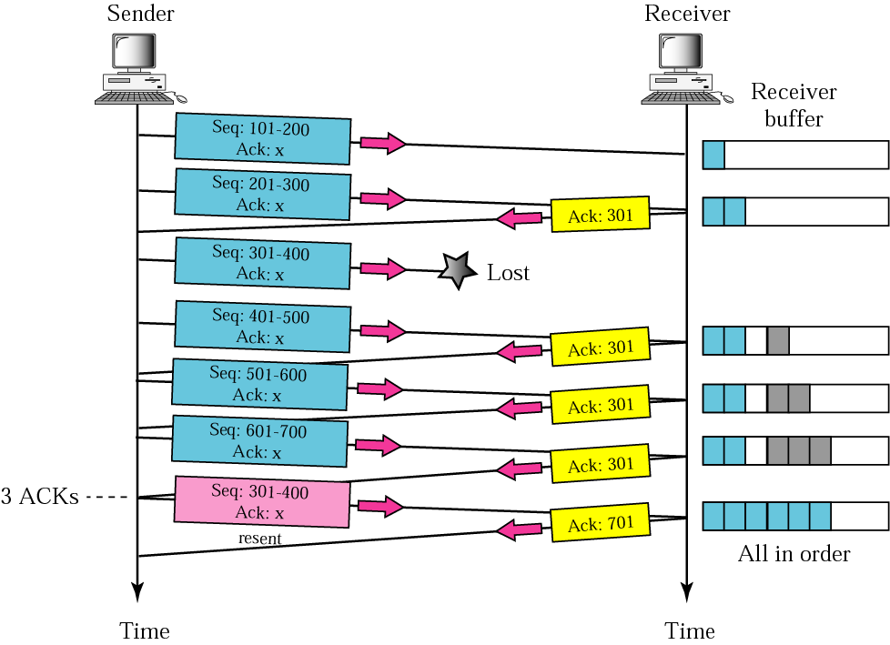
Fast retransmission
Notes:
Similar scenario as previous but this time the timer is larger, so large that it can rx 3 duplicate ack before the timer matures.

Slide 97
TCP sender (simplified)
data received from application above
create segment, seq. #: NextSeqNum
pass segment to IP (i.e., “send”)
NextSeqNum = NextSeqNum + length(data)
if (timer currently not running)
start timer
Λ
NextSeqNum = InitialSeqNum
SendBase = InitialSeqNum
wait
for
event
timeout
retransmit not-yet-acked segment with smallest seq. #
start timer
ACK received, with ACK field value y
if (y > SendBase) {
SendBase = y
/* SendBase–1: last cumulatively ACKed byte */
if (there are currently not-yet-acked segments)
start timer
else stop timer
}

Slide 98
TCP - Timeout
Notes:
להראות להם גישה ל-TCP דרך המכונות הוירטואליות

Slide 99
סרטון של כותבי הסרט
Notes:
https://media.pearsoncmg.com/aw/ecs_kurose_compnetwork_7/cw/videonotes-cw.php

Slide 100
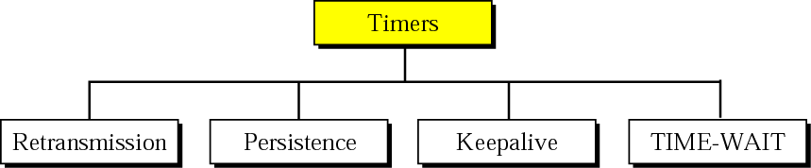
TCP timers
TIME-WAIT timer used during connection termination = 2MSL
Keepalive timer: prevent long idle connection btw 2 TCPs. Usually 2 hours. Then sends probe segment. After 10 probes terminates the connection.
Persistence timer: deals with deadlock created by Lost ACK. When persistence timer goes off send probe segment, contains only 1 byte. If not answered double the timer until threshold reaches (usually 60s). Then sends one probe every 60s until window reopened

Slide 101
How to set the retransmission timer ?
Retransmission Timer:
The setting of the retransmission timer is crucial for good performance of TCP
Timeout value too small → results in unnecessary retransmissions
Timeout value too large → long waiting time before a retransmission can be issued
A problem is that the delays in the network are not fixed
Therefore, the retransmission timers must be adaptive

Slide 102
Setting the value of RTO:
The RTO value is set based on round-trip time (RTT) measurements that each TCP performs
Each TCP connection measures the time difference between the transmission of a segment and the receipt of the corresponding ACK
There is only one measurement ongoing at any time (i.e., measurements do not overlap)
Figure on the right shows three RTT measurements

Slide 103
TCP timeout
Q: How to set TCP timeout value?
RTT… I know how to calculate but estimate RTT?
A: longer than RTT
SampleRTT: measured time from segment transmission until ACK receipt ignore retransmissions.
Good…?
but RTT varies…..?
too short: premature timeout, unnecessary retransmissions
too long: slow reaction to segment loss
SampleRTT will vary, want estimated RTT “smoother”
average several recent measurements, not just current SampleRTT

Slide 104
TCP - estimate timeout phase 1
EstimatedRTT = (1- α)*EstimatedRTT + α*SampleRTT
exponential weighted moving average
influence of past sample decreases exponentially fast
typical value: α = 0.125
RTT: gaia.cs.umass.edu to fantasia.eurecom.fr
RTT (milliseconds)
sampleRTT
EstimatedRTT
time (seconds)

Slide 105

TCP - estimate timeout phase 2
timeout interval: EstimatedRTT plus “safety margin”
large variation in EstimatedRTT -> larger safety margin
estimate SampleRTT deviation from EstimatedRTT:
DevRTT = (1-β)*DevRTT +
β*|SampleRTT-EstimatedRTT|
(typically, β = 0.25)
TimeoutInterval = EstimatedRTT + 4*DevRTT
estimated RTT
“safety margin”
Notes:
מסלול בוקר

Slide 106
What else do we need to know?
We know
How to open session
How to send segments and receive ACKs
How to close session
How to estimate the timer`
What to do when there is no problems
in the network and the receiver gets segments
… can you talk without breath?
What to do when the network has
problems…. Can you talk in the class
with others
Flow Control
Congestion Control
Notes:
אוניברסיטה בוקר

Slide 107
TCP - flow control
Notes:
אריאל - בוקר/ערב

Slide 108
TCP flow control
application
process
application may
remove data from
TCP socket buffers ….
application
TCP socket
receiver buffers
OS
… slower than TCP
receiver is delivering
(sender is sending)
TCP
code
flow control
receiver controls sender, so sender won’t overflow receiver’s buffer by transmitting too much, too fast
IP
code
from sender
receiver protocol stack

Slide 109
TCP flow control – What to Do
Receiver “advertises” free buffer space by including rwnd value in TCP header of receiver-to-sender segments
RcvBuffer size set via socket options (typical default is 4096 bytes)
many operating systems autoadjust RcvBuffer
Sender limits amount of unacked (“in-flight”) data to receiver’s rwnd value
Guarantees receive buffer will not overflow
to application process
RcvBuffer
buffered data
rwnd
free buffer space
TCP segment payloads
receiver-side buffering

Slide 110
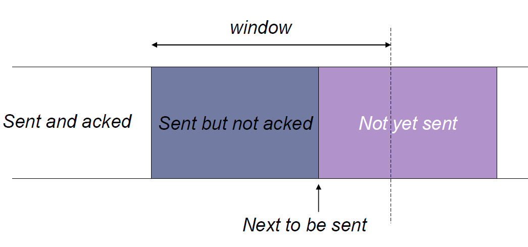
TCP flow control – Sender Side

Slide 111
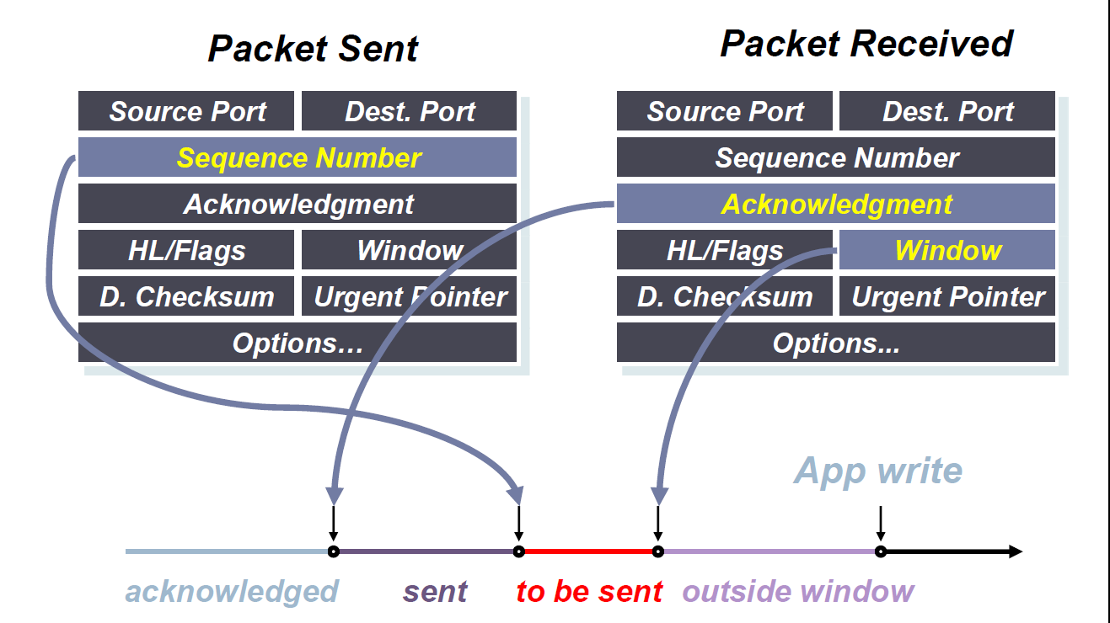
TCP flow control – Sender Side

Slide 112
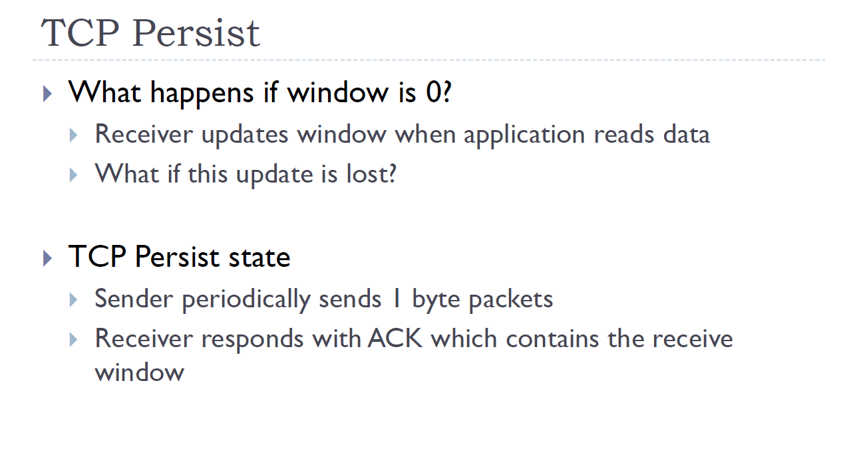
Data received to fast, to fast…. what to do….

Slide 113
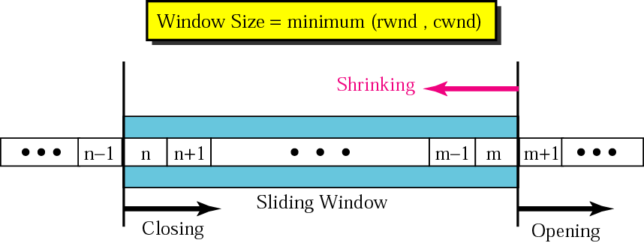
Sliding Window Flow Control
Here: Sender can transmit sequence numbers 6,7,8.
Sliding Window Protocol is performed at the byte level:

Slide 114
Sliding Window: “Window Closes”
Transmission of a single byte (with SeqNo = 6) and acknowledgement is received (AckNo = 5, Win=4):

Slide 115
Sliding Window: “Window Opens”
Acknowledgement is received that enlarges the window to the right (AckNo = 5, Win=6):
A receiver opens a window when TCP buffer empties (meaning that data is delivered to the application).

Slide 116
Sliding Window: “Window Shrinks”
Acknowledgement is received that reduces the window from the right (AckNo = 5, Win=3):
Shrinking a window should not be used

Slide 117
TCP – congestion control
Notes:
אוניברסיטה בוקר + ערב

Slide 118
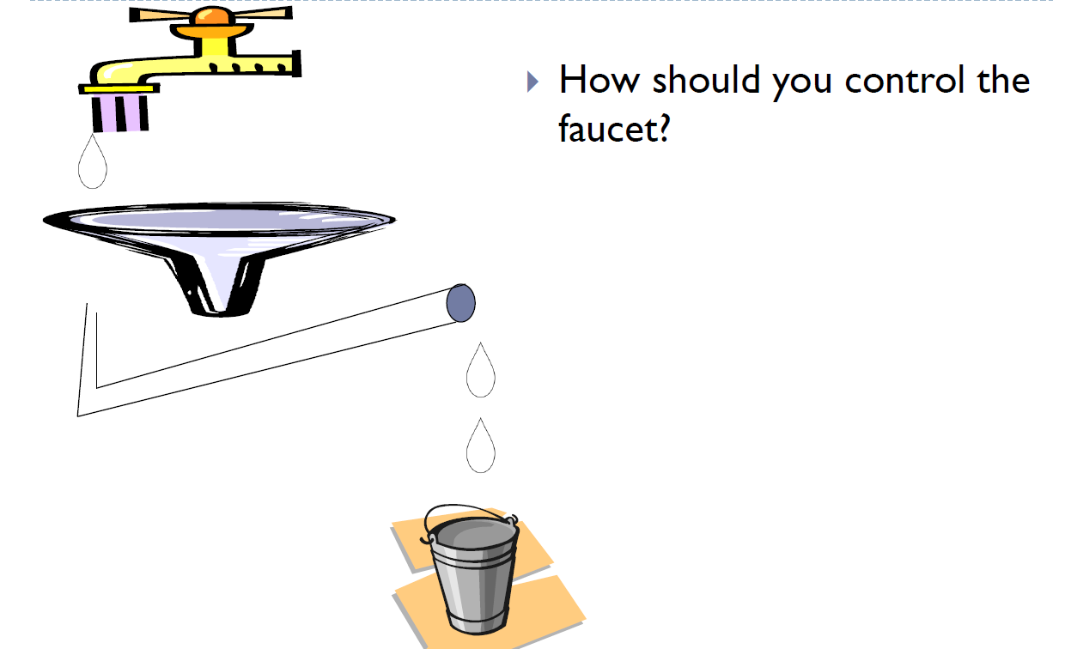
Internet Pipes

Slide 119
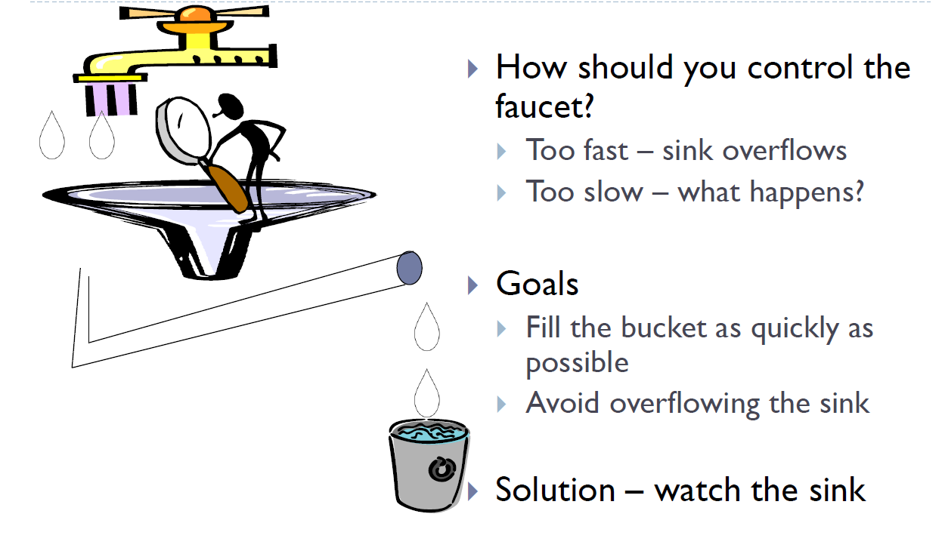
Internet Pipes

Slide 120
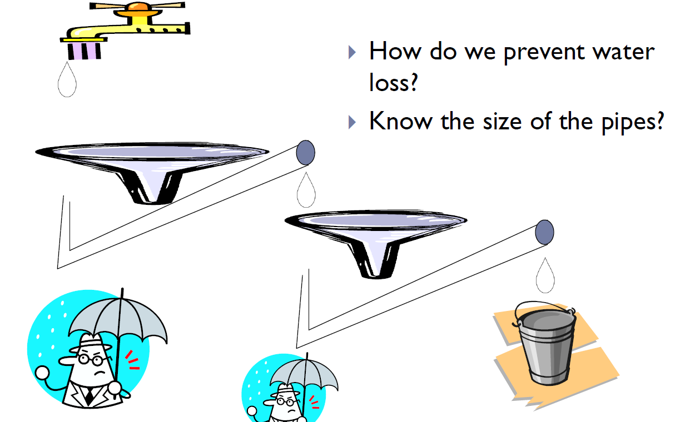
Plumbers Gone Wild!

Slide 121
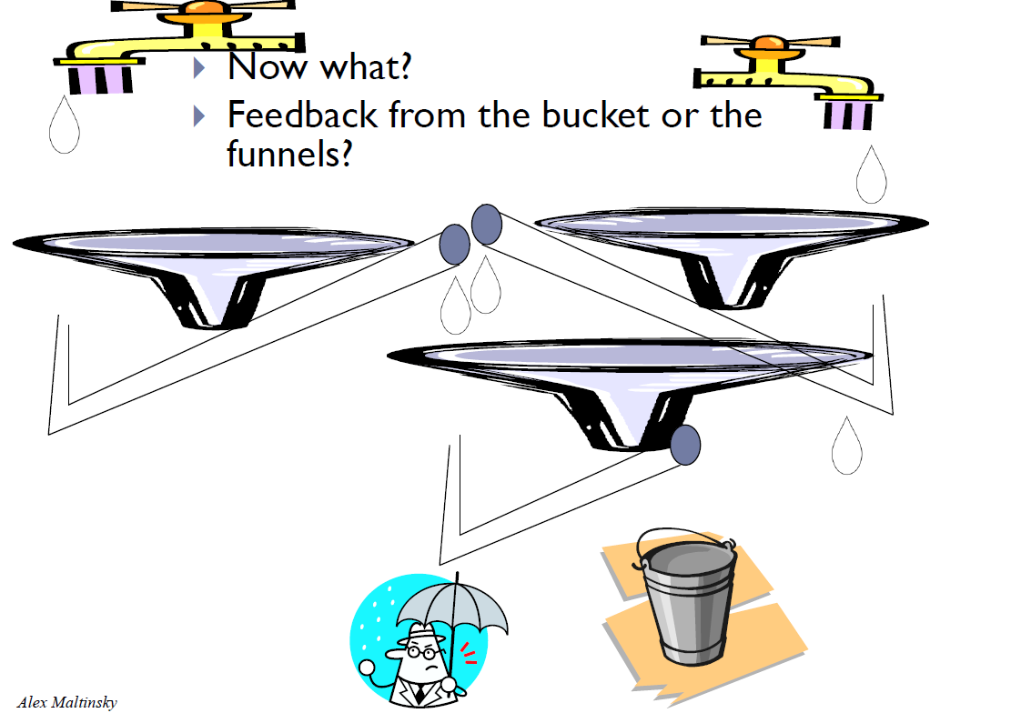
Plumbers Gone Wild -2
Notes:
אריאל בוקר

Slide 122
Principles of congestion control
congestion:
informally: “too many sources sending too much data too fast for network to handle”
different from flow control!
manifestations:
lost packets (buffer overflow at routers)
long delays (queueing in router buffers)
a top-10 problem!

Slide 123
Approaches towards congestion control
two broad approaches towards congestion control:
end-end congestion control:
no explicit feedback from network
congestion inferred from end-system observed loss, delay
approach taken by TCP
network-assisted congestion control:
routers provide feedback to end systems
single bit indicating congestion (SNA, DECbit, TCP/IP ECN, ATM)
explicit rate for sender to send at

Slide 124
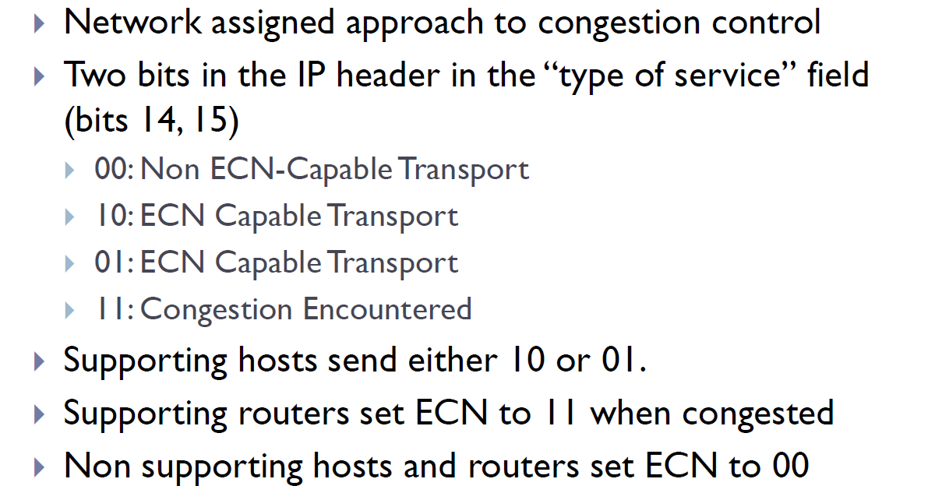
network-assisted congestion control - ECN

Slide 125
TCP congestion control: AIMD
approach: sender increases transmission rate (window size), probing for usable bandwidth, until loss occurs
additive increase: increase cwnd by 1 MSS every RTT until loss detected
multiplicative decrease: cut cwnd in half after loss
additively increase window size …
…. until loss occurs (then cut window in half)
AIMD saw tooth
behavior: probing
for bandwidth
cwnd: TCP sender
congestion window size
time
AIMD = additive increase multiplicative decrease

Slide 126
TCP Congestion Control: details
TCP sending rate:
roughly: send cwnd bytes, wait RTT for ACKS, then send more bytes
sender sequence number space
cwnd
last byte
ACKed
last byte sent
sent, not-yet ACKed
(“in-flight”)
rate
cwnd
~
bytes/sec
~
RTT
sender limits transmission:
cwnd is dynamic, function of perceived network congestion
LastByteSent-
LastByteAcked
cwnd
<

Slide 127
TCP Slow Start
When connection begins, increase rate exponentially until first loss event:
initially cwnd = 1 MSS
double cwnd every RTT
done by incrementing cwnd for every ACK received
Summary: initial rate is slow but ramps up exponentially fast
Host A
Host B
one segment
RTT
two segments
RTT
four segments
time

Slide 128

Congestion example
Notes:
(We assume max window size 32 and threshold set to half max window size)

Slide 129
TCP: detecting, reacting to loss
loss indicated by timeout:
cwnd set to 1 MSS;
window then grows exponentially (as in slow start) to threshold, then grows linearly
loss indicated by 3 duplicate ACKs: TCP RENO
dup ACKs indicate network capable of delivering some segments
cwnd is cut in half window then grows linearly
TCP Tahoe always sets cwnd to 1 (timeout or 3 duplicate acks)

Slide 130

TCP: switching from slow start to CA
Q: when should the exponential increase switch to linear?
A: when cwnd gets to 1/2 of its value before timeout.
Implementation:
variable ssthresh
on loss event, ssthresh is set to 1/2 of cwnd just before loss event

Slide 131
Refinement: inferring loss
After 3 dup ACKs:
CongWin is cut in half
window then grows linearly
Part of Fast Recovery
But after timeout event:
CongWin instead set to 1 MSS;
window then grows exponentially (This is SS)
to a threshold (ssthresh), then grows linearly
Philosophy:
3 dup ACKs indicates network capable of delivering some segments
timeout indicates a “more alarming” congestion scenario
Notes:
Fast Recovery: entering this state after the receipt of 3 dup. ACK’s. In this state, while receiving the duplicate ACK’s, increase CongWin as in SS (+1 MSS for every ACK)
When ACK for the missing segment arrives, cut CongWin in half and enter Congestion Avoidance phase.

Slide 132


Summary: TCP Congestion Control
New
ACK!
New
ACK!
.
duplicate ACK
new ACK
dupACKcount++
new ACK
cwnd = cwnd + MSS (MSS/cwnd)
dupACKcount = 0
transmit new segment(s), as allowed
cwnd = cwnd+MSS
dupACKcount = 0
transmit new segment(s), as allowed
Λ
cwnd = 1 MSS
ssthresh = 64 KB
dupACKcount = 0
cwnd > ssthresh
slow
start
Λ
congestion
avoidance
timeout
ssthresh = cwnd/2
cwnd = 1 MSS
dupACKcount = 0
retransmit missing segment
duplicate ACK
timeout
dupACKcount++
ssthresh = cwnd/2
cwnd = 1 MSS
dupACKcount = 0
retransmit missing segment
timeout
New
ACK!
ssthresh = cwnd/2
cwnd = 1
dupACKcount = 0
retransmit missing segment
New ACK
dupACKcount == 3
cwnd = ssthresh
dupACKcount = 0
dupACKcount == 3
ssthresh= cwnd/2
cwnd = ssthresh + 3
retransmit missing segment
ssthresh= cwnd/2
cwnd = ssthresh + 3
retransmit missing segment
fast
recovery
duplicate ACK
cwnd = cwnd + MSS
transmit new segment(s), as allowed

Slide 133

סגירת החלון עקב פקיעת ה RETRANSMISSION טיימר
Congestion detected
through timeout
Slow start threshold
set to half the
flight size at timeout
Slow start threshold
Congestion
Window
Size
Slow start
begins
Time
Congestion detected through timeout

Slide 134
Fast Retransmit and Fast Recovery Algorithms
במקרה של SEGMENT LOSS ה CWND לא יקודם בשני ה DUPLICATE ACK הראשונים
כאשר מתקבל ה DUPLICATE ACK השלישי יתבצעו הפעולות הבאות:
ה SSTRH יקבל ערך השוה למינימום בין חצי ה-CWND ו RWND (אבל לא פחות מ 2xSMSS )
CWND יקבל את הערך החדש של SSTRH ועוד 3xSMSS (שכן נשלחו עוד שלושה SEGMENTS שהגיעו ליעדם)
כל ACK שמגיע מגדילים את CWND ב SMSS
כאשר חוזר ה ACK עבור ה SEGMENT ששודר מחדש CWND יקבל את הערך של SSTRH
אם הטיימר של ה RETRANSMISSION פוקע ה CWND יקבל ערך של SMSS אחד (חזרה ל SLOW START)
השיטה הזאת נקראת TCP RENO. הקודמת שלא הבדילה בין TIMEOUT ל Fast Retransmit נקראה TCP TAHOE

Slide 135

סגירת החלון בעיקבות איבוד PACKET ללא פקיעת ה RETRANSMISSION טיימר
Congestion detected
through 3 duplicate ACKs
ssthresh set to half flight-size;
congestion window set to ssthresh + 3 MSS;
lost segment re-transmitted (fast retransmit)‏
Slow start threshold
ACK received for
Re-transmitted
Segment
Congestion
Window
Size
cwnd deflated
to value of
ssthresh.
Fast recovery
ends.
Congestion
avoidance
begins
Slow start
begins
Time
Congestion window opens by 1 MSS for each
Extra duplicate ACK received

Slide 136
Inflating the window
SMSS
Segment 32 is lost
…..
28
29
30
31
32
33
34
35
36
37
38
39
40
41
42
43
44
45
46
47
48
49
50
51
52
53
54
55
56
57
…..
Reduce the window
to ½ + 3
…..
28
29
30
31
32
33
34
35
36
37
38
39
40
41
42
43
44
45
46
47
48
49
50
51
52
53
54
55
56
57
…..
Inflate by 1 for every duplicate ACK
…..
28
29
30
31
32
33
34
35
36
37
38
39
40
41
42
43
44
45
46
47
48
49
50
51
52
53
54
55
56
57
…..
Receive duplicate ACK triggered by 43, Transmit 52
…..
28
29
30
31
32
33
34
35
36
37
38
39
40
41
42
43
44
45
46
47
48
49
50
51
52
53
54
55
56
57
…..
Receive duplicate ACK triggered by 44, Transmit 53
…..
28
29
30
31
32
33
34
35
36
37
38
39
40
41
42
43
44
45
46
47
48
49
50
51
52
53
54
55
56
57
…..

Slide 137
Deflating the window
Receive duplicate ACK triggered by 51, Transmit 60
31
32
33
34
35
36
37
38
39
40
41
42
43
44
45
46
47
48
49
50
51
52
53
54
55
56
57
58
59
60
61
62
63
64
ACK for lost packet and all following packets up to 51 is received
31
32
33
34
35
36
37
38
39
40
41
42
43
44
45
46
47
48
49
50
51
52
53
54
55
56
57
58
59
60
61
62
63
64
Deflate window to 10

Slide 138


Slide 139


Slide 140

Summary: TCP Congestion Control

Slide 141
Interactive Animations
TCP Congestion Control
Notes:
https://media.pearsoncmg.com/aw/ecs_kurose_compnetwork_7/cw/content/interactiveanimations/tcp-congestion/index.html

Slide 142
TCP throughput
avg. TCP throughput as function of window size, RTT?
ignore slow start, assume always data to send
W: window size (measured in bytes) where loss occurs
avg. window size (# in-flight bytes) is ¾ W
avg. throughput is 3/4W per RTT
W
W/2
3
W
avg TCP throughput =
RTT
bytes/sec
4

Slide 143
TCP Fairness
fairness goal: if K TCP sessions share same bottleneck link of bandwidth R, each should have average rate of R/K
TCP connection 1
bottleneck
router
capacity R
TCP connection 2

Slide 144
Why is TCP fair?
two competing sessions:
additive increase gives slope of 1, as throughout increases
multiplicative decrease decreases throughput proportionally
R
equal bandwidth share
loss: decrease window by factor of 2
congestion avoidance: additive increase
Connection 2 throughput
loss: decrease window by factor of 2
congestion avoidance: additive increase
Connection 1 throughput
R

Slide 145
Fairness (more)
Fairness and UDP
multimedia apps often do not use TCP
do not want rate throttled by congestion control
instead use UDP:
send audio/video at constant rate, tolerate packet loss
Fairness, parallel TCP connections
application can open multiple parallel connections between two hosts
web browsers do this
e.g., link of rate R with 9 existing connections:
new app asks for 1 TCP, gets rate R/10
new app asks for 11 TCPs, gets R/2
Notes:
אוניברסיטה - אחר צהריים

Slide 146


Maximum-segment-size / Window-scale factor
The value of MSS and window-scale factor is determined during connection establishment and does not change during the connection.
Notes:
The TCP header can have up to 40 bytes of optional information. Options convey additional information to the destination or align other options.
See http://publib.boulder.ibm.com/infocenter/pseries/v5r3/index.jsp?topic=/com.ibm.aix.prftungd/doc/prftungd/tcp_max_seg_size_tuning.htm
MSS = biggest unit of data that can be rx by dest TCP (not segment)
Each party defines the MSS it will rx during connec
Tcp guide:TCP is designed to restrict the size of the segments it sends to a certain maximum limit, to cut down on the likelihood that segments will need to be fragmented for transmission at the IP level. The TCP maximum segment size (MSS) specifies the maximum number of bytes in the TCP segment’s Data field, regardless of any other factors that influence segment size. The default MSS for TCP is 536, which results from taking the minimum IP MTU of 576 and subtracting 20 bytes each for the IP and TCP headers. (not clear see rfc 879)
Why windows scale ? Because even if win can reach 65000 byte, it might be not sufficient especially if traveling through channel with wide BW
Window Scale: Implements the optional window scale feature, which allows devices to specify much larger window sizes than would be possible with the normal Window field. The value in Option-Data specifies the power of two that the Window field should be multiplied by to get the true window size the sender of the option is using. For example, if the value of Option-Data is 3, this means values in the Window field should be multiplied by 8, assuming both devices agree to use this feature. This allows very large windows to be advertised when needed on high-performance links

Slide 147

Timestamp option
One application of the timestamp option is the calculation of round trip time (RTT).
The timestamp option can also be used for PAWS (Protect Against Wrapped Sequence numbers)
Notes:
When tx segment insert the value of the clock. The rx when send ack copy the value in the echo reply (and first field is all 0’s). Sender do not have even to remember the timestamp since inserted in the echo reply. When rx by the sender, look at clock and substract the time in echo reply
(wrapped : accapare)PAWS pb when high speed connec and 32 bit of seq num finished. Thus if first seg duplicated, can arrive in the new round, and wrongly taken as seg belonging to new round. One sol is to include the timestamp in the identif of a segment

Slide 148

SACK
SACK-permitted option used only during the connection establishment
SACK option reports about out of order and duplicate segments. Max 4 blocks.
Notes:
Till now only cumulative ack. Thus when out of order ack, sender does not know what arrive and what not, which can lead to useless retx if timeout expires. Does not also about duplicate, which can be useful to modify the RTO, perhaps too small
SACK allow to report about block (constitued with 2 byte to define seq number start and 2 byte to define the final seq num. can overcross several segment)
If duplicate mentionned at the beginning.

Slide 149

Example SACK

Slide 150
HTTP: Detecting Size of Message
TCP is a byte-stream - we do not know when one message ends and starts another.
Two general methods to detect end of message:
Application Protocol has a header where it is stated or end of message has a special protocol-specific marking – "End-Of-Message".
The three ways to detect the end of HTTP-body: - Header "Content-Length" – only for static content - Server closing the connection - Header "Transfer-Encoding: chunked" and body transfer in chunks for any content including dynamic. Zero Chunk marks the end.
Notes:
Capture at lecture: Search in Bing for "curl-loader". Observe header "Transfer-Encoding: chunked" and see body passed as chunks and ending to the Zero-Chunk.

Slide 151

Types of TCP
Notes:
http://www.youtube.com/watch?v=Vdc8TCESIg8
יכול להיות טוב לסיכום

Slide 152
שאלות
מה הקשר בין GBN, SR ו-TCP?
תשובה: שלושה פרוטוקולים שונים לאותה מטרה עם מנגנונים דומים.
על בסיס מה מחושב ה-timeout ב-TCP?
תשובה: דגימות של RTT.
לשם מה יש צורך במנגנון congestion control?
תשובה: עקב כך שאין אפשרות לדעת מה קצבי שידור הרשת בין המקור ליעד (קצב משתנה כל הזמן).
לשם מה יש צורך במנגנון flow control?
תשובה: עקב כך שאנו רוצים להמנע ממצב שהיעד זורק חבילות עקב תור עמוס.

Slide 153
שאלות
כמה פעמים אני צריך לקבל הודעה על מנת לשדר סגמנט שוב ואיזה הודעה זו?
תשובה: ack, אותו acknum 4 פעמים (מקור + 3 כפולים)
מדוע יש הבדל בטיפול בין timeout ל-fast retransmission?
תשובה: המקרה הראשון חמור יותר עקב כך שלא היה אפשרי להגיע ל-3 duplicate ולכן מצב הרשת קשה לעומת השני שמצב הרשת בעייתי אך לא קשה.
מדוע לאחר סגירת קשר יש להמתין timeout ארוך למרות שאנו לא מצפים לקבל חבילה?
תשובה: על מנת להיות בטוחים ככל האפשר שהקשר נסגר

Slide 154
Useful Links
TCP
http://www.youtube.com/watch?v=KSJu5FqwEMM&feature=related
Slow Start
http://www.youtube.com/watch?feature=endscreen&v=_sxeFJRVSXw&NR=1
RTT
http://www.youtube.com/watch?feature=endscreen&v=Wcjxpmh7C4U&NR=1
GBN, SR
http://www.youtube.com/watch?v=yT8SkFyRRrI
TCP VS UDP http://www.youtube.com/watch?v=Vdc8TCESIg8

Slide 155
TCP – מקרים ותגובות
Notes:
אריאל בוקר

Slide 156
מקרים ותגובות (חלק מהתשובות אינן נכונות)
נתון:
נתון מחשב A המתחבר לשרת B
מחשב A שולח ל- B קובץ בגודל 4000 בתים.
MSS הוא 500 בתים.
הנח שזמן שידור הודעות בקרה זניח ack, syn, fin…
מקרים:
תהליך תקין.
Ack הולך לאיבוד וחבילות אחרות מגיעות -> cumulative ack
מספר הודעות מגיעות ליעד אך ה-acks נופלים -> timeout
Timeout קצר יחסית לRTT – premature time out
הודעה הולכת לאיבוד אך ההודעות אחרי מגיעות -> duplicate acks
Notes:
להכין מסמך וורד עם הכל
אריאל ערב – סעיף ב

Slide 157
מקרים ותגובות
A
B
SYN
ACK + SYN
ACK + Seg(0)
ACK(500)
Seg(500)
Seg(1000)
ACK(1500)
Seg(1500)
Seg(2000)
Seg(2500)
ACK(2500)
Seg(3000)
Seg(3500)
ACK(3500)
ACK(4000)
Notes:
תהליך תקין.

Slide 158
מקרים ותגובות
A
B
SYN
ACK + SYN
ACK + Seg(0)
ACK(500)
Seg(500)
Seg(1000)
ACK(1500)
Seg(1500)
Seg(2000)
Seg(2500)
ACK(2500)
Seg(3000)
ACK(3500)
Seg(3500)
ACK(4000)
Notes:
Ack הולך לאיבוד וחבילות אחרות מגיעות -> cumulative ack
ציור נכון

Slide 159
מקרים ותגובות
A
B
SYN
ACK + SYN
ACK + Seg(0)
ACK(500)
Seg(500)
Seg(1000)
Time Out
ACK(1500)
Seg(500)
ACK(1000)
Seg(1000)
Seg(1500)
ACK(2000)
Seg(2000)
Seg(2500)
Seg(3000)
ACK(3000)
Seg(3500)
Notes:
מספר הודעות מגיעות ליעד אך ה-acks נופלים -> timeout
ציור לא נכון

Slide 160
מקרים ותגובות
A
B
SYN
ACK + SYN
ACK + Seg(0)
Time Out
ACK(500)
Seg(500)
Time Out
Seg(1000)
Seg(500)
ACK(1500)
Time Out
ACK(1500)
Seg(2000)
Seg(2500)
ACK(3000)
Seg(3000)
Time Out
Seg(3500)
ACK(4000)
Notes:
Timeout קצר יחסית לRTT – premature time out
אפשר לצייר אחרת

Slide 161
מקרים ותגובות
A
B
SYN
ACK + SYN
ACK + Seg(0)
ACK(500)
Seg(500)
Seg(1000)
ACK(1500)
Seg(1500)
Seg(2000)
Seg(2500)
ACK(1500)
Seg(3000)
Time Out
ACK(1500)
ACK(1500)
Assume Duplicate ack is after 2 dup
Notes:
הודעה הולכת לאיבוד אך ההודעות אחרי מגיעות -> duplicate acks
לא מושלם יש להוסיף הודעות

Slide 162
Signaling vs Data Path
Signaling Path includes:
Session opening
Session changes including negotiation on session conditions
Session closing
Data Path includes:
Only data transfer. However, it’s rare that a pure data-path exists without some signaling info added.
Q. Which packets of TCP are pure signaling (without data)?
Examples of pure signaling protocols: SDP an SIP

Slide 163
SIP – Session Initiation Protocol
VoIP – Voice over IP
Every VoIP textbook starts with: Vocaltec, 1994, Herzlia, Israel – the first VoIP call.
SIP – a signaling protocol in charge for:
Call establishment
Call conditions and parameters as well as joining/leaving participants
Call closing and cleanup
Clear text HTTP-like protocol: method + headers
Session parameters passed as SDP – clear text Session Description Protocol
Works either over UDP (95%) or TCP transport layer
Adds reliability at application level to work over UDP

Slide 164
SIP – Basic Call Flow
Alice
Proxy
Rob
INVITE
INVITE
100-Trying
180-Ringing
180-Ringing
200 OK
200 OK
ACK
ACK
RTP/RTCP Streams
BYE
BYE
200 OK
200 OK

Slide 165
SIP INVITE Example
INVITE sip:robert@Ghotit.com SIP/2.0
Via: SIP/2.0 sip-proxy.Ghotit.com:5061; branch = r4593h3
From: Alicesip:Alice@ariel.ac.il; tag=123456789
To: Robsip:robert@Ghotit.com
Call-ID: 12341234@10.0.1.15
Cseq: 1 INVITE
Content-Type: application/sdp
Content-Length: …
v = 0
o = Alice 28905345 28905345 IN IPV4 cyber-lab-host-13.ariel.ac.il
s = Session SDP
c = IN IPV4 cyber-lab-host-13.ariel.ac.il
t = 3035351354 0
m = audio 49170 RTP/AVP 0
a = rtpmap:0 PCMU/8000

Slide 166
More about multimedia

Slide 167

Real-time multimedia streaming
Real-time multimedia applications
Video teleconferencing
Internet Telephony (VoIP)
Internet audio, video streaming
(A-PDUs)

Slide 168
Streaming performance requirements
Sequencing
– to report PDU loss
to report PDU reordering
to perform out-of-order decoding
Time stamping and Buffering
for play out
for jitter and delay calculation
Payload type identification
for media interpretation
Error concealment –covers up errors from lost PDU by using redundancy in most-adjacent-frame
Quality of Service (QoS) feedback – from receiver to sender for operation adjustment
Rate control –sender reduces sending rate adaptively to network congestion

Slide 169

Ideal Timing – no jitter
00.00.00
00.00.10
First RTP-PDU
application
30 seconds
00.00.11
00.00.20
Second RTP-PDU
00.00.21
00.00.30
Third RTP-PDU
00.00.31
Send time
Play time

Slide 170
Reality – jitter
00.00.00
delay
00.00.10
First RTP-PDU
00.00.20
Second RTP-PDU
00.00.11
00.00.30
00.00.21
00.00.25
00.00.40
Third RTP-PDU
00.00.35
Fourth RTP-PDU
00.00.37
00.00.41
Send time
00.00.47
00.00.51
Play time

Slide 171
Reality – jitter
00.00.00
00.00.10
First RTP-PDU(0)
00.00.20
Second RTP-PDU(10)
00.00.11
00.00.30
00.00.21
00.00.18
00.00.25
00.00.40
Third RTP-PDU(20)
00.00.28
00.00.35
00.00.37
00.00.38
Fourth RTP-PDU (30)
00.00.41
Send time
00.00.47
00.00.48
00.00.51
Play time
00.00.58

Slide 172

Reality – jitter
Playback buffer
At time 00:00:18
At time 00:00:28
At time 00:00:38

Slide 173
How does Sequence number and Timestamp help ?
Audio silence example:
Seq no.1, Tmpst 100
Consider audio data
What should the sender do during silence?
Seq no.2, Tmpst 200
Seq no.3, Tmpst 300
Not send anything
sender
receiver
Why might this cause problems?
silence
Receiver cannot distinguish between loss and silence
Seq no.4, Tmpst 600
Seq no.5, Tmpst 700
Solution:
After receiving no PDUs for a while, next PDU received at the receiver will reflect a big jump in timestamp, but have the correct next seq. no. Thus, receiver knows what happened.

Slide 174
Support from transport layers
TCP is not used because:
TCP does retransmissions → unbounded delays
No provision for time stamping
TCP does not support multicast
TCP congestion control (slow-start) unsuitable for real-time transport
RTP + UDP usually used for multimedia services

Slide 175
RTP - Real Time Transport Protocol
TCP/IP
Not suitable for real-time
Retransmissions can lead to high delay and cause delay jitter
Does not support multicast
Congestion control mechanism (slow start) not suitable for AV media
UDP/IP
No defined technique for synchronizing
Streams from different servers may collide
A feedback channel must be defined for quality control

Slide 176
RTP Features
Multicasting
Payload type identification
Time shaping
Sequencing
Delivery monitoring

Slide 177
TCP – the future
Notes:
אוניברסיטה בוקר

Slide 178
Multi-path TCP

Slide 179








Endhosts have evolved
Mobile devices have multiple wireless interfaces

Slide 180


Multi-path TCP

Slide 181


Multi-path TCP
3G celltower
IP 1.2.3.4
Notes:
ajouter adresse ip

Slide 182
Multi-path TCP
3G celltower
IP 1.2.3.4
IP 5.6.7.8

Slide 183
Multi-path TCP
3G celltower
IP 1.2.3.4
IP 5.6.7.8

Slide 184
Multi-path TCP
Now, think about all the new problems:
Open/close session in multipath
Sequence and Ack Sequence
3G celltower
IP 1.2.3.4
IP 5.6.7.8

Slide 185
A naïve Multipath TCP
SYN+Option
SYN+ACK+Option
ACK
seq=123, "abc"
seq=126, "def"

Slide 186

A naïve Multipath TCP In today's Internet ?
SYN+Option
SYN+ACK+Option
ACK
seq=123, "abc"
There is no corresponding TCP connection
seq=126, "def"

Slide 187
How to combine two TCP subflows ?
SYN+Option
SYN+ACK+Option
ACK
SYN+OtherOption
How to link with
blue subflow ?
SYN+ACK+OtherOption
ACK

Slide 188
How to link TCP subflows ?
SYN, Port_{src}=1234,Port_{dst}=80+Option
SYN+ACK[...]
A NAT could change addresses and port numbers
ACK
SYN, Port_{src}=1235,Port_{dst}=80
+Option[link Port_{src}=1234,Port_{dst}=80]

Slide 189
How to link TCP subflows ?
SYN, Port_{src}=1234,Port_{dst}=80 +Option[Token=5678]
SYN+ACK+Option[Token=6543]
ACK
MyToken=5678
YourToken=6543
MyToken=6543
YourToken=5678
SYN, Port_{src}=1235,Port_{dst}=80
+Option[Token=6543]

Slide 190
The Next HTTP

Slide 191
STOP!! What about latency ??
HTTP is getting dangerously close to closing all the outstanding 1.1 bugs. :)
New multimedia technology emerged
Http1.1 +TCP has latency problems ☹
One transfer per connection. At most six parallel connections.
Resulting in typical load times of 3.8-10.5 seconds.
No session priority.
SPDY\HTTP2 is a protocol designed for low-latency transport of content over the World Wide Web"

Slide 192
HTTP 2 - Introduction
Who created it? Known implementations.
IETF’s HTTP Working Group
RFC 7540: https://tools.ietf.org/html/rfc7540
Originally, it was based of Google’s SPDY/2 (Mike Belshe and Roberto Peon) but further changed
Fully compatible with HTTP/1.1
Includes HTTP Version Negotiation Mechanism to ensure seamless inter-operability with 1.1 (Header – Upgrade)
Supported at the client side: Chrome, Safari, IE-11, Edge, Firefox
Supported by the servers:
Apache – full support since 2.4.27, module mod_http2
Microsoft IIS – since Win-10 and Win-Server-2016
Ngnix – from 1.9.5
Supported by CDNs: Akamai, CDN77, Claudflare, AWS CloudFront

Slide 193
The Big Server Push
The Big White Shark 1
HTTP/1.1 Browser gets a page
The browser parses it and detects the links and the resources (images, iframes, CSS) required
The browsers opens several TCP connections to get the resources in parallel
All that suffers of RTTs and opening of multiple connections
Instead, HTTP 2 browser gets a page with all dependent resources ready to use – thanks to the Server Push of the resources

Slide 194

The Big Server Push
The Big White Shark 2

Slide 195

The Big Server Push
The Big White Shark 3

Slide 196
A Single Server Connection
… but with Multiplexing
HTTP 2 browser is using a single connection with multiplexing, any number of outstanding (not answered) requests:
Saves server-side resources
Not stalls with “head-of-line blocking”
More fairly loads potentially congested networks making CA to work properly
Enables “true pipelining” with multiple request and response messages to be in flight at the same time

Slide 197
Binary and Headers Compression
Déjà Vu – Back to 70s-80s
Binary means robust and reliable
For example 4-ways to parse in HTTP 1.1 (https://www.w3.org/Protocols/rfc2616/rfc2616-sec4.html#sec4.4) versus a single way for HTTP 2 (https://tools.ietf.org/html/rfc7540#section-4.1)
But binary is less flexible and debugging requires in-depth understanding of the protocol
Wireshark plugin is the expert: https://bugs.wireshark.org/bugzilla/show_bug.cgi?id=9042
HTTP Headers are passed compressed
It was demonstrated that long (uncompressed) headers can impact TCP Slow Start and make the transfer much longer.

Slide 198
Compression Under Attack
Security Driven Protocol Design
SPDY/2 had a single gzip context
CRIME schema is effective to break it and leak sensitive info: https://en.wikipedia.org/wiki/CRIME_(security_exploit)
Attacker observes the size of the cipher-text sent by browser and directs the browser to the target web-site
The attacker then observes the change in size of the compressed request payload containing both the secret cookie/message and the variable content created by the attacker
Making the variable content smaller and smaller the secret message could be extracted
Prevention: don’t use compression or use HPACK (HTTP 2)
BREACH is a general exploit for compressed HTTP https://en.wikipedia.org/wiki/BREACH_(security_exploit)

Slide 199
Compression Under Attack
Security Driven Protocol Design
HTTP 2 uses HPACK, RFC-7541
https://tools.ietf.org/html/rfc7541
HPACK is Huffman based
HPACK is more robust without known vulnerabilities

Slide 200

Basic Data Flow
Streams of Headers and Data

Slide 201
Encryption
To encrypt, or not to encrypt
Encryption is NOT a MUST
No support for Opportunistic Encryption / STARTTLS
But the discussion continues
Browsers do require encryption and that makes it de-facto requirement
HTTP/2 defines a profile of TLS that is required:
The minimum version – TLS 1.2
A cipher-suite blacklist
Extensions: Server Name Indication is a MUST
Target domain name MUST be stated upon TLS negotiation
More details like TLS 1.2 MUST disable compression, etc.
See at: https://tools.ietf.org/html/rfc7540#section-9.2

Slide 202


Slide 203


Slide 204


Slide 205
QUIC

Slide 206
How do you make the web faster?
$BROWSER
HTTP/1.1
TLS 1.2
User-perceived latency
TCP
IP
Physical Network
google.com
Notes:
Copied from Redefining Internet Transport Janna Iyengar

Slide 207
How do you make the web faster?
$BROWSER
HTTP/1.1
TLS 1.2
User-perceived latency
TCP
IP
Physical Network
Build a carrier-grade network
Google CDN
google.com
google.com
Notes:
Copied from Redefining Internet Transport Janna Iyengar

Slide 208
How do you make the web faster?
$BROWSER
Launch your own browser
Update HTTP
Chrome
HTTP/1.1
HTTP/2
TLS 1.2
User-perceived latency
TCP
IP
Physical Network
Build a carrier-grade network
Google CDN
google.com
google.com
Notes:
Copied from Redefining Internet Transport Janna Iyengar

Slide 209
How do you make the web faster?
$BROWSER
Launch your own browser
Update HTTP
Chrome
HTTP/1.1
HTTP/2
TLS 1.2
User-perceived latency
TCP
???
IP
Physical Network
Build a carrier-grade network
Google CDN
google.com
google.com
Notes:
Copied from Redefining Internet Transport Janna Iyengar

Slide 210
QUIC Features
0-RTT connection handshake
0-RTT encryption handshake
Connections survive IP address change
Enhanced packet loss recovery
Always encrypted
Mostly fixes head of line blocking
FEC (Forward Error Correction) data recovery

Slide 211
HTTP/2 Features in QUIC
Multiplexed streams
Sharing connection across domains
HPACK header compression
Stream prioritization
Flow Control
Server­initiated streams

Slide 212
QUIC
Congestion control, encryption, and some HTTP/2 move to QUIC
Notes:
Runs in user-space

Slide 213
Streams
One stream per request
Stream are broken up into frames
Stream 1 crypto handshake
Stream 3 is for headers – to serialize headers (HPACK)

Slide 214
Multiplexed Streams
HTTP/1.1
4-8 outstanding requests on 4-8 connections
Resource intensive on the server
HTTP/2 and QUIC
One connection, many concurrent requests
Normally limited to 100

Slide 215
Connection Sharing
Multiple domains over one TCP connection
Domain must be in certificate and resolve to same IP

Slide 216
Prioritization
Ability for clients to set a priority of a stream
Dependency tree for streams
Higher weights get more resources
Resources proportional to the weighting

Slide 217
Flow Control
Client and server
Connection and streams
Credit based
Default 64KB – clients and server normally set this higher
Requires updates by WINDOW_UPDATE frame

Slide 218
Server-Initiated Streams
Should send push before referencing resource - race condition
Response must be cacheable
Depending on the use case can be faster or slower
Browser already has the resource cached
Client canceling the stream using RST_STREAM frame

Slide 219
Establishing a QUIC Connection
HTTP response header
Alternate-Protocol: 443:quic
Client establishes QUIC connection in the background
Client’s can cache if server supports QUIC

Slide 220
QUIC - Connections
Handshake
0-RTT for reestablished connections
1-RTT for new connections
Accounts for 50% latency improvements
Will use TLS 1.3 handshake
UDP encrypted and authenticated packets
TCP like header are encrypted
Prevents active attacks and middlebox changes unlike TCP
Moved congestion control into application layer
Connections are keep-alive for 30 seconds (default) due to NATs

Slide 221
QUIC - Connections
Unencrypted connection ID (64-bit)
Connections survive IP address change
Used for routing connections
ICW remembered by the client for reestablished connections

Slide 222

QUIC Success Rate
QUIC connection success rate
92% works
7% doesn’t work
1% is rate limited
Google disables QUIC to specific ASNs
Notes:
Chart copied from Redefining Internet Transport Janna Iyengar

Slide 223
QUIC Performance
5% latency reduction on average
30% reduction in rebuffers (video pauses) on YouTube
1 second faster at the 99th percentile for Google web search
Helps more for higher latency networks

Slide 224
QUIC Features in TCP and TLS
Feature | Server Support | Client Support
TCP
Increasing TCP's Initial Window | RHEL 6.2 | N/A
Computing TCP's Retransmission Timer | RHEL 6.3 | N/A
CUBIC Inflated Window Bug | RHEL 6.7 | N/A
TCP Fast Open | ATS done, RHEL 7.2 | IOS, OSX, Android needs to be enabled
TCP Loss Probe | RHEL 7 | N/A
Early Retransmit for TCP | RHEL 7 | N/A
TCP Packet Pacing | RHEL 7.2 | N/A
RACK: a time-based fast loss detection algorithm for TCP | Linux 4.4 | N/A
ICW 32 | Dependent on TCP enhancements | N/A
TLS
TLS 1.3 | RFC not done

Slide 225
QUIC Status
Draft 2 in IETF
https://tools.ietf.org/html/draft-tsvwg-quic-protocol-02
Waiting on TLS 1.3

Slide 226
QUIC Potential Issues
UDP rate limiting and blocking
More CPU usage on client and server
DOS attacks

Slide 227
QUIC Support
Client
Chrome enable by default
Wireshark support
Library
libquic / goquic
proto-quic
First release 4/1
Supported by Google

